Slide 1
Principles of Management
2018

Slide 2
Overview of Management
Definition of Management
Management is the attainment of organizational goals in an effective and efficient manner through planning, organizing, staffing, directing and controlling organizational resources.
Organizational resources include men, machines materials, money.
The process of reaching organizational goals efficiently and effectively by working with and through people and other organizational resources.
Goals may be to create surplus.
Management is concerned with “Doing the right things right at all times”:
Notes:
Management is concerned with “Doing the right things right at all times”:
Effectiveness: Achievement of objectives (Right Things);
Efficiency: Achieving those objectives with least amount/ sacrifice of resources (Things Right);
Continuous Improvement: in creating increasing ‘surplus’ (at all times);
“Improve or die” = survival of the fittest
“what gets measured, gets managed and improved” e.g. Productivity= Output / Input ratio
“Management is the process of designing and maintaining an environment in which individuals, working together in groups, efficiently accomplish selected aim(s) viz. to create a surplus(s).” …. Weihrich & Koontz

Slide 3
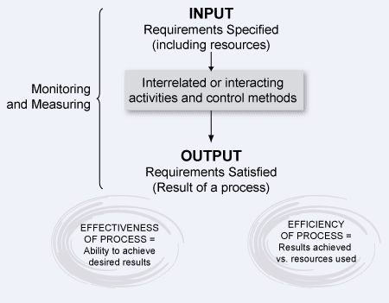

Slide 4
Definition of Management Gurus speak
The use of people and other resources to accomplish objectives - Louis E Boone & David L Kurtz-.
The act of getting things done through people - Mary Parker Follet.
Management as the art of knowing what you want to do in the best and cheapest way - Frederick Taylor.

Slide 5
History of Management Development
Developed gradually through centuries to its present formidable state.
Theories & approaches
The Classical approach
Human Resource Approach
The Modern approach

Slide 6
Classical Approach
The Classical Perspective to management emerged during the nineteenth century and continued till the twentieth century.
Due to new challenges the organizations faced management sought methods of efficiency which included a rational and scientific approach

Slide 7
The Classical Approaches
The classical approach includes the following three theories and their contributors:-
Scientific Management by Frederick Taylor
Administrative Principle by Henry Fayol
Bureaucratic Organization by Max Weber

Slide 8
Scientific Management by Frederick W Taylor
Scientific Management or Taylorism was a scientific method which was used to optimize the way in which tasks were performed thus improving the labor productivity.
One of Taylor’s philosophy was
“In the past man must has been first. In the future system must be first”.

Slide 9
F.W. Taylor
Founder Father of Scientific Management
Focus is higher Productivity by better utilization of workers.
Introduced Management responsibility is to
1. Identify elements of man’s work
2. Each work should be assigned to a workman and to train them, instead of leaving to the workmen to choose.
3.Manufacturing Process should be designed by Management in a scientific way and accepted by the workman.
4. Management and Workman responsibility are to be well defined and spelt out for the work.

Slide 10
5 Functions of Management Process
as defined by Henry Fayol
Henry Fayol has identified the following 5 functions of management.
Planning
+ Organizing
+ Staffing
+ Leading
+ Controlling
to accomplish certain pre-determined, (as derived from stakeholder needs) goals or objectives

Slide 11
Human Resource Approach
Motivation

Slide 12
Human Behavior management
Elton Mayo-Father of Human Relation approach.
Based on Hawthorne Studies he established –
Organization not merely a formal structure but a live and dynamic social system.
Feeling of a member of a Team and a sense of participation is a greater motivating force than improving working condition
Efficiency depends on mental condition and his relation with his superiors and colleagues
A common psychological bond that exists among the members of the group influence the conduct of the group.
Emotions , including prejudices play a major role in shaping the behavior of the group.
Group behavior overrides individuals
Human and social incentives are greater influence than financial.

Slide 13
Maslow’s Theory of Human’s Needs
Maslow’s hierarchy of needs is a theory of psychology that contends each one of us is motivated by needs.
Maslow’s Needs states that we must satisfy each need in order, starting with the first, which deals with the most obvious needs of survival, food and shelter first.
Only when the lower order needs of physical requirements are met, people looks forward to satisfy the emotional needs, which fulfills the esteem and self-actualization needs..

Slide 14
Maslow’s Hierarchy of Needs
Self –Actualization Personal Growth & Fulfillment
Esteem Needs Achievement, Status, Responsibility, Reputation
Belongingness and Love needs Family, Affection, Groups, etc.
Safety Needs Protection, Security, Law & Order, Stability etc.
Biological and Physiological Needs Food, Water, Shelter, etc.

Slide 15
Needs
Maslow’s Theory states that
Needs must be satisfied in the given order . It moves from Level 1 to 5; once the lower one is met, it shifts to higher order.
Levels 1 to 4 is Deficiency Need (motivator) and Level 5 is a Growth Need (motivator)
Examples he used as
You cant motivate to achieve their sales target (level 4) when they are having problems in their marriage
You cant expect someone to work effectively as a Team member(level3) when they are having their house re-possessed i.e. security problem(level2)

Slide 16
Needs in Social and Occupational perspective
Personal/Social Needs | Need Hierarchy | Occupational Needs
Personal Growth, Fulfillment | Self Actualization | Advancement
Approval, Achievement | Esteem Needs | Recognition, High status
Family, Friends, Community | Belongingness & Love Needs | Coworkers, Groups, & Clients
Protection, Law, Freedom | Safety Needs | Benefits, Stability, Occupational Safety
Food, Air Water, Sleep | Biological & Physical Needs | Proper Temperature, Air, Basic Salary

Slide 17
ERG Theory.
In 1969, Clayton Alderfer's revision of Abraham Maslow’s Hierarchy of Needs, called the ERG Theory.
ERG theory
Existence,
Relatedness
and Growth
and was created to align Maslow's motivation theory more closely with empirical research.

Slide 18
Differences from Maslow's Needs Hierarchy
Alderfers ERG theory demonstrates that
More than one need may motivate at the same time.
A lower motivator need not be substantially satisfied before one can move onto higher motivators.

Slide 19
Differences
The ERG theory also accounts for differences in need preferences between cultures better than Maslow's Need Hierarchy;
The order of needs can be different for different people.
It can explain the "starving artist" who may place growth needs above those of existence.

Slide 20
Differences
The ERG theory acknowledges that if a higher-order need is frustrated, an individual may regress to increase the satisfaction of a lower-order need which appears easier to satisfy.
This is known as the frustration-regression principle.

Slide 21
Herzberg's theory of motivators and hygiene factors
Herzberg (1959) constructed a two-dimensional paradigm of factors affecting people's attitudes about work.
He concluded that such factors as company policy, supervision, interpersonal relations, working conditions, and salary are hygiene factors rather than motivators.

Slide 22
Herzberg
According to the theory, the absence of hygiene factors can create job dissatisfaction, but their presence does not motivate or create satisfaction.

Slide 23
Herzberg’s Motivators
The motivators were elements that enriched a person's job;
He found five factors in particular that were strong determiners of job satisfaction:
achievement,
recognition,
the work itself,
responsibility,
and advancement.

Slide 24
Herzberg
These motivators (satisfiers) were associated with
long-term positive effects in job performance
The hygiene factors (dis-satisfiers) consistently produced
only short-term changes in job attitudes and performance, which quickly fell back to its previous level.

Slide 25
Theory X and theory Y
Theory X and Theory Y are theories of human motivation created and developed by Douglas McGregor at the MIT Sloan School of Management in the 1960s

Slide 26
Theory X and Theory Y
Theory X | Theory Y
The average individual dislikes work and will avoid it whenever there is opportunity | The average individual likes to work and it’s a natural activity
Most people must be forced or penalized to get them effectively achieve the organizations goals | A person could be self motivated and is committed to their work
The average human has little or no ambition and would avoid responsibility but like the security or benefits | The average human learns to accept and seek responsibility
 | Has the capacity to be innovative and creative
 | The potential of a human under modern industrial is moderately utilized

Slide 27
Theory X
In this theory, management assumes
This theory is a negative view of employees.
Employees are inherently lazy and will avoid work if they can and that they inherently dislike work.
According to this theory, employees will show little ambition without an enticing incentive program and will avoid responsibility whenever they can.

Slide 28
Theory X
If the organizational goals are to be met, theory X managers rely heavily on threat and coercion to gain their employee's compliance.
Beliefs of this theory lead to mistrust, highly restrictive supervision, and a punitive atmosphere.

Slide 29
Theory Y
In this theory, management assumes employees are ambitious and self-motivated and exercise self control.
It is believed that employees enjoy their mental and physical work duties.
They possess the ability for creative problem solving,
Given the right conditions, most people will want to do well at work.
They believe that the satisfaction of doing a good job is a strong motivation.

Slide 30
Criticisms
Taken too literally any such dichotomy including Theory X and Y seem to represent unrealistic extremes.
Most employees (and managers) fall somewhere in between these poles.

Slide 31
Modern Approach to Management
Elements of various perspectives, mostly the humanistic perspective evolved into what is known as the Modern Management approach.
Includes following theories
Open Systems
Contingency System
Lesson from Japanese style of management (Theory Z)

Slide 32
Theory Z
Theory Z focused on increasing employee loyalty to the company by providing a job for life with a strong focus on the well-being of the employee, both on and off the job.
According to Ouchi, Theory Z management tends to promote stable employment, high productivity, and high employee morale and satisfaction.

Slide 33
Levels of Management
Top Management: provide the overall direction of an organization Chief Executive Officer, President, Vice President
Middle Managers:
Coordinate employee activities
Determine which goods or services to provide
Decide how to market goods or services to customers
Assistant Manager, Manager (Section Head), General Manager
First-line Managers: have direct responsibility for producing goods or services Foreman, supervisors, clerical supervisors

Slide 34
Top Management
Top management sets organizational goals, strategies to implement them and make decisions.
Top management rationally process and interpret information in a complex situation and take decisions and guide others.
Those decisions, along with the way the management members treat the staff, affect the success of the company.
It is the top management who establish procedures and policies that helps establish the corporate culture.
A corporate culture, which makes the organization transparent encourages creativity and innovation.
The top management of a company leads by example and affects the motivation felt by the employees.
A management team that takes a sincere interest and connects with the staff is more likely to inspire the employees to achieve.

Slide 35
Middle Managers
Responsible for setting objectives that are consistent with top management’s goals and translating them into specific goals and plans for first-line managers to implement. They work as a bridge.
Responsible for coordinating activities of first-line managers. Should have both the knowledge of the process and human skill to guide and motivate the first line managers.
Establish target dates for products/services to be delivered
Need to coordinate with others for resources
Ability to develop others is important
Rely on communication, teamwork, and planning and administration competencies to achieve goals

Slide 36
First-line Managers
Directly responsible for production of goods or services
Employees who report to first-line managers do the organization’s work, generally the non-managers.
Spend little time with top managers in large organizations
Technical expertise is important.
Rely on planning and administration, self-management, teamwork, and communication competencies to get work done

Slide 37
Managerial Skills
TECHNICAL SKILLS
A person’s knowledge and ability to make effective use of any process or technique constitutes his technical skills.
eg: Engineer, accountant, lawyer, doctor, etc.
HUMAN SKILLS
An individual’s ability to cooperate with other members of the organization work effectively in teams, and motivate others.
eg: Interpersonal relationships, helping others to solve problems and welcome to be in the team and also the ability to lead.
CONCEPTUAL SKILLS
Ability of an individual to analyze complex situations and to rationally process and interpret available information.
eg: Idea generation and analytical ability to process information and take actions in a complex situation.

Slide 38
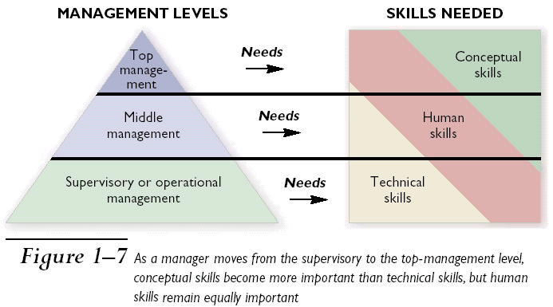
Management Level and Skills

Slide 39
POSDCORB-CEO’s Responsibility
In his "Notes on the Theory of Organization“ Luther Gullick talked about the work of CEO.
Planning
Organizing
Staffing
Directing
Coordinating
Reporting
Budgeting
He mentioned that if an executive's workload becomes too overwhelming, some of the elements of POSDCORB can be organized as subdivisions of the executive, depending on the size and complexity of the enterprise.

Slide 40
Mintzberg’s Managerial Roles
Henry Mintzberg undertook a study on the CEO’S job at work and found that they are engaged in a large number of varied, un-patterned and short duration activities, most of such activities lasted less than nine minutes.
Mintzberg concluded that managers perform 10 different but highly interrelated roles, known as Mintzberg’s Managerial roles.
The term Managerial roles refer to specific categories of managerial behavior.
These 10 roles can be grouped under three primary headings:
Interpersonal Relationship
The Transfer of Information
Decision Making

Slide 41
Mintzberg’s Managerial Roles
ROLE | DESCRIPTION | IDENTIFIABLE ACTIVITIES
Interpersonal
Figurehead | Symbolic head, sets ethical standard | Legal & Social interactions
Leader | Staffing, Training and Motivating employees | Activity related to all employees
Liaison | Maintaining outside contacts for favors & coordinate between dept.s | Developing and nurturing outside contacts& coordinate
Informational
Monitor | Seeks and receives information about organization for control | Evaluate performance of managers in different functions
Disseminator | Shares information received from others for cohesion and progress. | Holding formal & informal internal meetings, shares vision
Spokesperson | Communicate to external world | Holding Board meetings
Decisional
Entrepreneur | Work as Change agent for better | Organize & review program
Disturbance Handler | Responsible for corrective action | Crisis management works
Resource Allocator | Approving all kind of resources | Budgeting & programming
Negotiator | Involve in all major negotiations | Labor union, Supplier, Customer interactions
Notes:
INTERPERSONAL ROLE
Figurehead- ethical guidelines and the principles of behavior employees are to follow in their dealings with customers and suppliers
Leader- give direct commands and orders to subordinates and make decisions
Liaison-coordinate between different departments and establish alliances between different organizations
INFORMATIONAL ROLE
Monitor- evaluate the performance of managers in different functions
Disseminator-communicate to employees the organization’s vision and purpose
Spokesperson- give a speech to inform the local community about the organization’s future intentions
DECISIONAL ROLE
Entrepreneur- commit organization resources to develop innovative goods and services. Takes unchartered routes.
Disturbance handler- to take corrective action to deal with unexpected problems facing the organization from the external as well as internal environment
Resource allocator- allocate existing resources among different functions and departments
Negotiator- work with suppliers, distributors and labor unions

Slide 42
Hierarchy of Objectives & Org. Levels
Vision & Mission
Top Management
Overall
Objectives &
Key result areas.
Overlaps,
depending on the
organization
structure
Divisional objectives
Middle Management
Departmental objectives
Individual objectives
First Line Managers
Objectives set end results – they need to be supported by a hierarchy of sub-objectives, duly networked through the organization to avoid discord and wasted effort.

Slide 43
FUNCTIONS OF MANAGEMENT
The process of achieving the goals are the basic functions of Management , which are
PLANNING
ORGANIZING
STAFFING
DIRECTING
CONTROLLING

Slide 44
PLANNING
Planning is determining the objectives and formulating the methods to achieve them.
Planning involves
identifying what tasks must be performed
outlining how the tasks must be performed, and
indicating when they should be performed
to attain organizational goals,.
A job well planned is half done.
During planning the following basic questions need to be answered:
What am I trying to accomplish i.e. what is my objective?
What resources do I have and do I need to accomplish the same?
What are the methods and means to achieve the objectives?
When the job should be accomplished to meet the organizational objectives?
Is this the optimal path to best serve the organizational objective (Efficiency and Effectiveness)?

Slide 45
Benefits of Planning
Planning establishes coordinated effort.
It gives direction to managers and non-managers alike the direction the organization is going and what they must contribute to reach the objective.
By forcing managers to look ahead,
anticipate change, consider the impact of change and develop appropriate responses, planning reduces uncertainty.
Planning also reduces overlapping and wasteful activities.
Coordination before that activities take place, helps to uncover wastes and redundancies.
Planning establishes objectives or standards that facilitate control.
In planning, objectives are developed. In the controlling function, performance is compared against the established objectives to facilitate taking corrective actions in case of deviation.

Slide 46
Types of Plans
The most popular ways to describe plans are in terms of their
Breadth
Strategic vs. Tactical
Strategic plans include the formulation of objectives, where as Tactical plans describe how these objectives will be attained.
Time frame
Long term vs. Short term
Plans should extend for a time frame which is enough to carry through those commitments that are made today. Short term plans are normally less than one year and the long terms are more than 3 years.
Specificity
Directional vs. specific
Directional plans are flexible which set out general guideline in order to respond to unexpected changes in a highly uncertain environment. Specific plans have clearly defined objectives and reduce problems due to ambiguity.
And Frequency of use
Single use vs. Standing
Single use plan is used to meet the needs of a particular or unique situation. Standing plans provide guidance for repeatedly performed actions in an organization.

Slide 47
Strategic vs. Tactical Planning
Strategic plans
drive the organization’s efforts to achieve its goals. As these plans filter down the organization, they serve as a basis for the tactical plans.
Tactical plans
are sometimes referred to as Operational plans.
Strategic and Tactical plans differ in three primary ways ;-
Time frame
Scope, and
-- known set of organizational objectives.
Time frame & Scope
Tactical plans tend to cover shorter period of time. For instance, an organization’s monthly, weekly and day-to-day plans are almost all Tactical. Strategic plans tend to cover longer period of time and deal less with the specifics.
Objectives
Strategic plans include the formulation of objectives, whereas Tactical plans assume the existence of objectives.

Slide 48
Tactical Plans to Functional Plans
Functional plans indicate how different operations within the organization will help accomplish the overall strategy
Production plans
Financial plans
Facilities plans
Marketing plans
Human resource plans
Logistics plans

Slide 49
Operational Plans
Operational plans identify short-term activities to implement strategic plans
Policies are standing plans that communicate guidelines for decisions
Procedures are rules that describe actions to be taken in specific situations
Budgets are plans that commit resources to projects or activities
Zero based budgets allocate resources as if each budget were brand new

Slide 50
Types of Plans
Type of Plan | Time Frame | Specificity | Frequency of Use
Strategic | Long Term | Directional | Single Use
Tactical | Short Term | Specific | Standing
Functional | Ongoing | Very detailed | Day-to-day
Operational-(Policies, procedures, and rules) | Varies | Varies | Varies

Slide 51
Objective Setting
Of all the functions involved in management, planning is the most important. As the old saying goes, “Failing to plan is planning to fail”.
Setting goals and objectives is the first and most critical step in the planning process.
Although the terms “goals” and “objectives” are often used interchangeably, there is a difference between them:
Goals Objectives
General Specific
Intangible Measurable
Broad Narrow
Abstract Concrete
Strategic – long-range direction, set Tactical – short-range, set by top executives by managers to accomplish goals

Slide 52
Management By Objective (MBO)
MBO was developed by Peter Drucker .
The concept of MBO is closely connected with the concept of planning. The process of planning implies the existence of objectives and is used as a tool/technique for achieving the objectives.
It is a process through which
specific goals are set collaboratively
for
the organization as a whole and
every unit and
individual within;
the goals are then used as a basis
for
planning,
managing organizational activities and
assessing and rewarding contributions.

Slide 53
MBO- an integrated planning and control framework.
MBO is based on the assumption that
people perform better when they know what is expected of them and can relate their personal goals to organizational objectives.
According to the classical theory of management, top management is concerned with objectives setting, directing and coordinating the efforts of middle level managers and lower level staff. However, achievement of organizational objectives is not possible without the cooperation and participation of all persons.
When objectives are set through collective participation, ownership for accomplishment passes downward making the achievement of such objectives easy and quick.
However, MBO not only sets goals but also assigns responsibilities for achieving the same along with authority.

Slide 54
MBO Principles
Cascading of organizational goals and objectives
Align individual targets with corporate objectives
Set performance standards
Participative decision making to agree to the set objectives for each member
Establish a management information system to monitor achievements against objectives
Performance evaluation and feedback

Slide 55
MBO aims at
MBO aims to serve as a basis for
greater efficiency through systematic procedures,
greater employee motivation and commitment
through participation in the planning process.
MBO plans for results instead of planning just for work for a specified period.
MBO provides for
Standards for measuring accomplishment of performance objectives .
Procedures for reviewing performance results.

Slide 56
MBO
Advantages
Focuses employees on most important tasks and objectives.
Focuses supervisor’s efforts on important areas of support.
Contributes to relationship building.
Gives employees a structured opportunity to participate in decision making.
It fosters motivation
It forces managers to plan ahead
Disadvantages
Its time consuming and expensive
It can be misused as a punitive device
Focusing too much attention on easily quantifiable objectives.
Having managers to inform subordinates their objectives.

Slide 57
MBO is not an all pervasive solution
Management by Objectives (MBO) was first outlined by Peter Drucker in 1954 in his book 'The Practice of Management'.
In the 90s, Peter Drucker himself decreased the significance of this organization management method, when he said: "It's just another tool. It is not the great cure for management inefficiency... Management by Objectives works if you know the objectives, 90% of the time you don't."

Slide 58
Organizing
Organizing means assigning the planned tasks to
various individuals or groups within the organization and creating a mechanism to put plans into action.
Includes creating
departments and
job descriptions
It helps in the process of deciding
where decisions will be made,
who will perform what jobs and tasks, and
who will report to whom in the company

Slide 59
Characteristics of an Organization
An organization has a structure.
An organization consists of a group of people striving to reach goals that individuals acting alone could not achieve.
Goals are the purpose that an organization strives to achieve;

Slide 60
Structure Variables
Principles
Chain of command
Span of control
Authority
Power
Responsibility
Departmentalization
Functional
Divisional
Product
Customer
Geographic
Process

Slide 61
Organization Design
Organization Design is a process in which managers develop or change their organization’s structure.
An organization structure defines how job tasks are formally divided, grouped and coordinated.
This process involves making decisions about how specialized jobs should be allocated, the rules to guide employees’ behaviors, and at what levels decisions are to be made.
Six basic elements of organization structure:
Work specialization
Departmentalisation
Unity of command/ Scalar Chain
Span of control
Centralization vs. decentralization, and
Formalization

Slide 62
Elements of Organization Structure
Work Specialization-
In Work Specialization , a job is broken down into a number of steps and each step is completed by an individual or group of individuals, rather than having one individual do the whole job .
Work specialization makes efficient use of diversity of skills that workers hold (Forging, Machining, Welding, Assembly, Painting, etc. before the final product is dispatched).
Departmentalization
Once the jobs have been divided through work specialization, these jobs have to be grouped together so that common tasks can be coordinated. The basis by which jobs are grouped together is called departmentalization.
There are commonly used five departmental structures, discussed in next two slides:

Slide 63
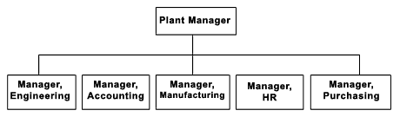
Departmentalization Classifications…
Functional Departmentalization
The activities can be grouped by functions performed. Functional departmentalization seeks to achieve economics of scale by placing people with common skills and orientations into common units.
Product Departmentalization.
It groups jobs by product line. Each manager is responsible of an area within the organization depending of his/her specialization
XYZ Automotive Ltd
Car
Commercial Vehicles
Heavy Vehicles
Notes:
In Functional organization the tasks, people, and technologies necessary to do the work of the business are divided into separate “functional” groups (such as marketing, operations, and finance).

Slide 64
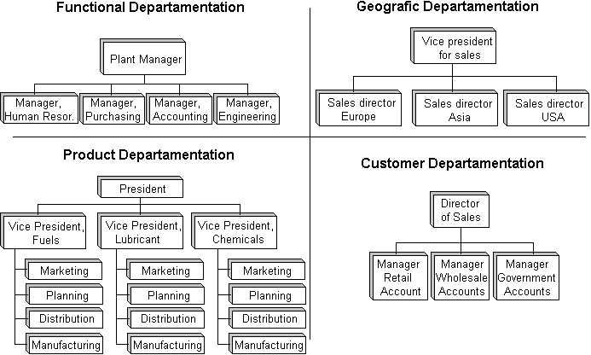
Departmentalization
Based on geographical
territory
Based on customer
segmentation
Process Departmentalization. It groups on the basis of process, for organization where special skills are required to manage the processes.
E.g. Inspection and Shipping department may be one for all the products and customers.

Slide 65
Matrix Organizational Structure
The matrix organizational structure is one in which specialties of both functional and product are combined to provide the advantage of the functional specialization along with focus to simplify and amplify the focus of resources on a narrow but strategically important
product, project, market, customer,
or innovation .

Slide 66
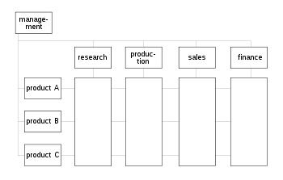
Matrix Organizational Structure
Strictly speaking matrix management is the practice of pooling people with similar skills for work assignments and are managed with more than one reporting line

Slide 67
Elements of Organization Structure
Scalar Chain & Unity of Command:
The unity of command principle helps preserve the concept of an unbroken line of authority. It states that a person should have one and only one superior to whom he or she is directly responsible and straight chain of command (Scalar Chain) that extends unbroken from the top to the bottom.
Span-of-Control
The purpose of organizing is to make human cooperation effective and is limited by the number of persons a manager can ‘supervise’ effectively and efficiently.
“Effective span” is influenced by maturity of managers to skill of the subordinates; from clarity of plan to clarity of delegation.
Notes:
Scalar chain is the formal line of authority which moves from highest to lowest rank in a straight line. This chain specifies the route through which the information is to be communicated to the desired location/person. Straight chain of command that extents unbroken from the ultimate officer to the lowest ranks.

Slide 68
Factors affecting Span of Control
Key factors to review when determining the appropriate span of control within an organization include the following:
Geographical Location, if the branches of a business are widely dispersed, then the manager will find it difficult to supervise each of them, as such the span on control will be smaller.
Organizational size. Large organizations tend have a narrow span of control, whereas smaller organizations often have a wider span of control.
Workforce skill level. Skill level required and competency of the work force (professionally qualified workforce) affects the span of control. Further, Theory Y type of people, need not be supervised much as they are motivated and take initiative to work, as such the span of control will be smaller.
Nature of Job. The complexity or simplicity of the tasks performed by the employees will affect the number of desirable direct reports. If the task that the subordinates are performing are similar, then the span of control can be wider, as the manager can supervise them all at the same time.
Organizational culture. Flexible workplaces usually have a wider span of control because employees are given more autonomy and flexibility in their work.

Slide 69
Fayol’s bridge
Scalar chain in the organization structure provides for straight chain of command that extends unbroken from the ultimate officer to the lowest ranks. The principle suggests that there should be a clear line of authority from top to bottom linking all managers at all levels. It is considered a chain of command.
To avoid information overload in a large organization having scalar chain and unity of command,
Henry Fayol has proposed that subordinate employees should be allowed to communicate directly with each other.
This principle became known under the name of Fayol's bridge.
Decision power is distributed to individuals on lower levels in the organization, and only decisions that exceed the pre-defined decision scope of an employee are referred upwards.

Slide 70
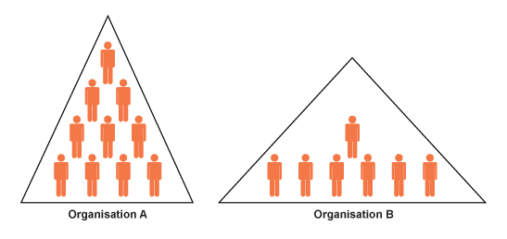
Tall vs. Flat Structure
Organization Structure are classified into in to a tall (vertical) (Organization A) structure or
a flat (horizontal) (Organization B) structures.
Large, complex organizations often require a taller hierarchy. In its simplest form, a tall structure results in one long chain of command similar to the military.
Flat structures have fewer management levels, with each level controlling
a broad area or group.
Flat organizations focus on empowering employees rather than adhering to
the chain of command. Small organizations generally have flat structures.

Slide 71
Centralized vs Decentralized Structure
The degree to which the authority is delegated within an organization is indicated by Centralization and Decentralization.
A centralized structure has a greater degree of control, while a decentralized structure involves a greater degree of delegated authority to the regions or to subordinates.
Centralized Keep decision making power at the top of the hierarchy 2) Don't delegate to local or lower levels | Decentralized 1) Power and authority to make decisions delegate from head office to lower and local levels 2) Less uniformity 3) Decisions made in relation to local circumstances
Advantages 1) Consistent policies, greater control and standardized procedures 2) Quicker decision making 3) Branches are identical, so customer knows what to expect 4) Tight financial control | Advantages 1) Empower local managers 2) Local knowledge may benefit decentraliszd operation managements (e.g. sales and promotional initiatives) 3) Reduces day to day communication with head office 4) Business is more flexible as it is able to respond to local issues faster 5) Improved motivation and performance
Disadvantages 1) Local managers may have better knowledge of customer needs 2) Motivation of local managers may be affected 3) Inappropriate decision at local level | Disadvantages 1) Customers may prefer the uniformity of branches 2) Local managers may not see the bigger picture

Slide 72
Contingency variables Affecting Structures
The most appropriate structure to use will depend on contingency factors.
There are two generic organization structures:
Mechanistic Organization
Organic Organization

Slide 73
Mechanistic Organization
The Mechanistic Organization (Bureaucratic) is the natural result of combining the six elements of structure.
Adhering to the chain–of-command principle ensured the existence of a formal hierarchy of authority, with each person controlled and supervised by one person.
Keeping the span of control small at increasingly higher levels in the organization created tall, impersonal structures with increasing rules and regulations for standard practices.
In such organization, work specialization creates jobs that are simple, routine and standardized.

Slide 74
Organic Organization
The Organic organization is a highly adaptive form that is as loose and flexible as the mechanistic organization is rigid and stable.
It has division of labor, but the jobs people do are not standardized.
Employees tend to be professionals who are technically proficient and trained to handle diverse problems.
The organic organization is low in centralization so that the professional can respond quickly to problems
Low in Centralization:
because top management cannot be expected to possess all the varied expertise that is necessary to make decision.

Slide 75
Other New Age Structures
Multi-national Structure, -common in global companies, such as Procter & Gamble, Toyota, Unilever etc.
This structure can be seen as a complex form of the matrix, as it maintains coordination among products, functions and geographic areas.
In general, over the last decade, it has become increasingly clear that through the forces of globalization, competition and more demanding customers, the structure of many companies has become flatter, less hierarchical, more fluid and even virtual.
Team Structure
One of the newest organizational structures developed in the 20th century is Team Structure.
In small businesses, the team structure can define the entire organization
Teams can be both horizontal and vertical.
While an organization is constituted as a set of people who synergize individual competencies to achieve newer dimensions, the quality of organizational structure revolves around the competencies of teams in totality

Slide 76
HISTORICAL OPINIONS ABOUT ORGANIZATIONAL EFFECTIVENESS
FREDERICK TAYLOR
EFFECTIVENESS WAS DETERMINED BY FACTORS SUCH AS PRODUCTION MAXIMIZATION, COST MINIMALIZATION, TECHNOLOGICAL EXCELLENCE, Etc.
HENRI FAYOL
EFFECTIVENESS IS A FUNCTION OF CLEAR AUTHORITY AND DISCIPLINE WITHIN AN ORGANIZATION
ELTON MAYO
EFFECTIVENESS IS A FUNCTION OF PRODUCTIVITY RESULTING FROM
EMPLOYEE SATISFACTION

Slide 77
Defining Organizational Effectiveness
Organizational effectiveness is the concept of how effective an organization is in achieving the outcomes the organization intends to produce.
There are many ways to measure the effectiveness of an organization including productivity, profits, growth, turnover, stability and cohesion based on theoretical perspectives.
Rational perspective
Rational perspectives emphasize goal attainment and focus on output variables such as quality, productivity, and efficiency.
Natural system perspective
Natural system perspectives focus on the support goals of the organization such as employee satisfaction, morale, interpersonal skills, etc.
Open system perspective
Open system perspectives focus on the exchanges with the environment -- this includes information processing, profitability, flexibility, adaptability. Effectiveness criteria also vary with time, and often subgroups have different effectiveness criteria.

Slide 78
TIME
DIMENSION
NEAR
FUTURE
INTERMEDIATE
FUTURE
DISTANT
FUTURE
The organization
must be
1. EFFECTIVE in accomplishing its goal(s)
EFFICIENT in the acquisition and use of scarce resources
A SOURCE OF
SATISFACTION to its owners, employees, customers and clients, and society.
The organization
must be
4. ADAPTIVE to
new opportunities
and obstacles
5. CAPABLE OF
DEVELOPING
the ability of its
members and of
itself
The organization
must be
6. CAPABLE OF
SURVIVAL in
a world of
uncertainties.
EFFECTIVENESS
CRITERIA

Slide 79
APPROACHES TO MEASURING ORGANIZATIONAL EFFECTIVENESS
Goal Approach: Effectiveness is the ability to excel at one or more output goals, where goals are clear, time bound and measurable.
System Resource Approach: Effectiveness is the ability to acquire scarce and valued resources from the environment, where a clear connection exists between inputs and outputs.
Constituency Approach: Effectiveness is the ability to satisfy multiple strategic constituencies both within and outside the organization and the constituencies (stake holders) have powerful influence on the organization.
Internal Process Approach: Effectiveness is the ability to excel at internal efficiency, coordination, motivation, and employee satisfaction, which includes costs, outputs & satisfaction.

Slide 80
Goal Approach
INPUTS
TRANSFORMATION
OUTPUTS
GOAL APPROACH
Effective output

Slide 81
System Resource Approach
INPUTS
TRANSFORMATION
OUTPUTS
SYSTEM RESOURCE APPROACH
Efficiency in input to output

Slide 82
Constituency Approach
INPUTS
TRANSFORMATION
OUTPUTS
STRATEGIC CONSTITUENCIES APPROACH
Efficiency in meeting Stakeholder’s requirement

Slide 83
Internal Process Approach
INPUTS
TRANSFORMATION
OUTPUTS
INTERNAL PROCESS APPROACH
Efficiency in the conversion process

Slide 84
Business & Its Environment
There is a great deal of interaction between a business organization and its environment.
Inputs are taken into the business organization from the environment for the conversion process and the output is made for the customer, who are outside in the environment.
Inputs from the open system constitutes of labor, machines, raw materials and finance.
An organization is a socio-technical system.
The technical system includes tasks, tools and operating techniques.
The social system consists of members of the organization.
Both of the systems are in interaction yet interdependent of each other.
The technical system affects inputs and outputs.
The social system determines the effectiveness and efficiency of the utilization of technology.
The organization structure, a third sub-system links the social system with the technical system.
Generally, an organization is a dynamic system, constantly changing and adapting to internal and external pressures.

Slide 85
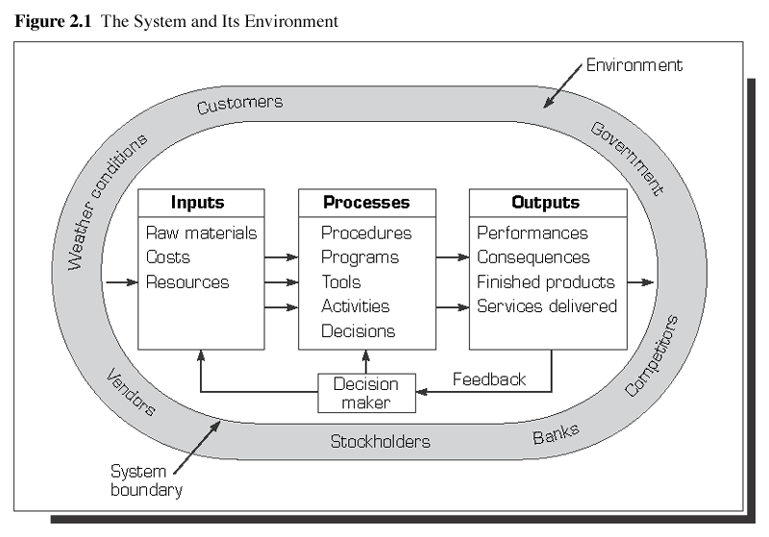

Slide 86
Closed and Open Systems
A Closed System is totally independent of other systems and subsystems
An Open System is very dependent on its environment as a continuum
Defining manageable boundaries is closing the system

Slide 87
DSS- Decision Support System, where challenge is how to best utilize the data
provided by the software. One approach is to import the data into
Decision Support Systems (DSS) to build special-purposed decision aids.

Slide 88
Management and the Society
All organizations irrespective of their goals, operate amidst changing external environment that affects and influences their strategic decisions.
Management particularly at the senior and top management levels need to consider external factors for effective decision making.
Macro-environments that affects working of all or most organizations include
economic systems, economic conditions, political systems, demographics, cultural background, technology and legal framework.
All the macroeconomic factors need to be continuously monitored and their implications on the operations of the organization need to be

Slide 89
Who Are Business Stakeholders?
Government
Employees
Business
Community
Owners
Consumers

Slide 90
Definition of CSR
0
CSR policy functions as a
built-in, self-regulating mechanism
whereby a business monitors and ensures its active compliance with the spirit of the law, ethical standards, and international norms to meet their social responsibilities.
The social responsibility of business encompasses the
economic,
legal,
ethical and
philanthropic (discretionary) expectations that society has from organizations at a given point in time.

Slide 91
Four-Part Definition of CSR
0
Responsibility
Societal
Expectation
Examples
Economic
Required
Be profitable. Maximize sales, minimize costs.
Legal
Required
Obey laws, adhere to regulations
Ethical
Expected
Avoid questionable practices. Do what is right, fair, and just
Philanthropic
Desired/ Expected
Be a good corporate citizen. Give back.
Figure 2-2

Slide 92
Going Beyond-Legal Responsibilities
0
Law cannot address all the topics or issues that business may face
Law often lags behind more recent concepts of what is considered appropriate behavior
Laws are made by lawmakers and may reflect the personal interests/motivation of legislators rather than appropriate ethical justifications

Slide 93
The Pyramid of CSR
0
Philanthropic Responsibilities Be a good corporate citizen.
Ethical Responsibilities Be ethical.
Legal Responsibilities Obey the law.
Economic Responsibilities Be profitable.
Figure 2-3

Slide 94
The CSR Equation
0
Economic Responsibilities
Legal Responsibilities
Ethical Responsibilities
Philanthropic Responsibilities
+
Total Corporate CSR
+
=
+

Slide 95
Corporate Governance
Corporate governance is about promoting corporate fairness, transparency and accountability.
It is defined as a
process
and
structure
used to direct and manage the business and affairs of the company
towards enhancing business prosperity
and
corporate accountability
with the ultimate objective of realizing long-term shareholder value,
whilst taking into account the interest of other stakeholders.

Slide 96
Corporate Governance
It is concerned with creating a balance between
economic and social goals
between individual and community goals while encouraging efficient use of resources,
accountability in the use of power and stewardship and
as far as possible to align the interests of individuals,
corporations and society.
Good governance is not simply about corporate excellence.
It is the key to economic and social transformation.
The corporation of today are no longer sheer economic entities. These are the engines of economic and social transformation.

Slide 97
Corporate Governance Practices
Good corporate governance practices involve:
The corporate governance framework should protect shareholders rights.
The corporate governance framework should ensure the equitable treatment of all shareholders.
Stakeholders should be involved in corporate governance.
Disclosure and transparency is critical.
The board of directors should be monitored and held accountable for what guidance it gives.

Slide 98
Ethics
Ethics is a branch of philosophy that involves systematizing, defending and recommending concepts of right and wrong conduct, often addressing disputes of moral diversity.
The term comes from the Greek word ethos, which means "character".
Since ethics emanate from philosophy and not science, there is no singular correct answer to what is ethical.
There are three types of moral theories pertaining to normative ethics
Utilitarian theory
Theory based on rights, and
Theory of justice

Slide 99
Ethics- Different views
Utilitarian View: Utilitarian theory suggests that plans and actions of managers should give rise to greatest benefit and good to the largest number of people. It implies the greatest good for the greatest number as a criteria for weighing and evaluating decisions. In this a decision can be viewed as ethical, even if few people are adversely or negatively affected by it.
Rights view: The rights view focuses on the premise that individuals have basic rights that must be protected, irrespective of associated cost to the society or to the organization.
Justice View: The justice view is grounded in the idea that rules of organizational or societal existence must be imposed equitably to all. The focus is making a decision that is objective, without prejudice to emotions and fair to every one involved.
Ethics
Utilitarian view
Right view
Justice view

Slide 100
Business Ethics & Code of Ethics
Business ethics relate to true and honest practices that are adhered to in the conduct of business in various areas of operation, such as advertising, competition, public relations, social responsibilities, consumer liberty and independence.
Business ethics are often guided by law, which provides a basic framework that businesses may choose to follow in order to gain public acceptance.
Business ethics are implemented in order to ensure that a required level of trust exists between consumers and various forms of market participants with businesses.
Code of ethics is a statement of policies, principles and rules that define the boundaries within which an individual, or for that matter every profession and organization should behave.

Slide 101
Ethical Standards & Responsibilities
Ethical Standards refers to principles that when followed, promote values such as trust, good behavior, fairness, and/or kindness.
There is no consistent set of standards that all companies follow, but each company has the right to develop the standards that are meaningful for the organization.
Ethical standards are rules and regulations that establish acceptable conduct.
Many industries and businesses have their own set of ethical standards.
Ethical responsibilities
It refers to taking actions and doing things that are right, just, and fair for the society and do not cause any harm to people in general

Slide 102
People Management
Employees are the biggest asset for any organization. Their performance and attitude can result in the success or failure of the business.
Management is responsible for hiring, firing, disciplining, training and evaluating. These functions at times seem to be at odds with each other.
It focuses on hiring the right people and then getting the most out of these people.
This requires consistent policies and practices in place to provide its people with appropriate training and development creating a work environment where employees feel as "partners" to the business.
Unlocking people potential is often seen as the key to any business's success.
When an employee's talents are not channeled correctly, their behavior can seriously compromise the success of an organization.
In case of any identified weaknesses, developing workforce to overcome the weaknesses becomes important for any organization to get the best out of an employee.
Employee involvement and empowerment through recognition and training and making the workforce feel as an important asset of the organization is an important step for the success of an organization.

Slide 103
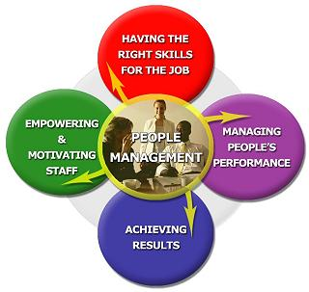
People Management
Recruiting And Selecting
The "Right" Person For The Job
Performance Appraisal
To help managing people’s
Performance
Engaging and
maximizing
people’s
potential
Focus on the right work priorities
and develop solutions to problems

Slide 104
The Role of HR Managers
People Management functions are performed by both professional HR managers as well as operating managers, supervisors, departmental heads, group heads.
Although devising HRM policies is the exclusive task of HR specialists, operating managers operationalize the same policies. The involvement of operating managers becomes imperative, as they have to effectively manage all resources at their disposal.
With HR gaining more importance in the present information and knowledge age, companies need to have effective HR policies and practices to gain a distinctive advantage over their competitors.
HRM planning, programming, review and evaluation ensure that the right number and kind of people are made available at the right time to effectively implement the company’s business plan.
Human Resource Managers have to synchronize their activities with the business plan of the organization to ensure that the right type and number of people are made available to different functions of an organizations in line with their contribution to the organization al goals.
The above coupled with the development of the employee’s training need and facilitate their developments to meet the organizational goals are important role of the HR managers, which facilitate and enhances organization’s success.

Slide 105
Job Design
Job Designed refers to the way in which sets of interrelated tasks – leading to a desired and expected outcome are organized.
While designing jobs, the needs and goals of the employees and the organization need to be considered and aligned.
It contains
Tasks to be performed (content)
How they are to be performed (method)
How many actions are to be performed within the tasks (steps involved)
In what order the actions have to be done (sequencing)
The knowledge, skills and attitudes required to perform the task efficiently and effectively (optimum performance).
Thus Job Design is defined as the process of defining the content of a job in terms of its duties and responsibilities, methods, techniques and systems and procedures for carrying out the job;
The relationships that should exist between the job holder and his/her superiors, subordinates and colleagues.

Slide 106
Recruitment & Selection
The recruitment and selection is the major
function of the human resource department
Recruitment process
is
the first step towards creating the competitive strength
and
helps in building long term strategic edge to the organizations.

Slide 107
Recruitment
Recruitment process involves
a systematic procedure from sourcing the
candidates to arranging and conducting the
interviews and requires many resources and
time. A general recruitment process is as
follows:

Slide 108
Recruitment Process
1. Identify vacancy
2. Prepare job description and person specification
3. Advertising the vacancy
4. Managing the response
5. Short-listing
6. Arrange interviews
7. Conducting interview and decision making

Slide 109
Recruitment Process
Identifying the vacancy:
These contain:
• Posts to be filled
• Number of persons
• Duties to be performed
• Qualifications required

Slide 110
Recruitment & Selection
Importance of Recruitment
The Purpose and Importance of recruitment are given below:
The level of performance of an organisation depends on the effectiveness of its recruitment function.
Attract and encourage more and more candidates to apply in the organisation.
Create a talent pool of candidates to enable the selection of best candidates for the organisation.

Slide 111
Importance of Recruitment
Determine present and future requirements of the organization in conjunction with its personnel planning and job analysis activities.
Create links between the employers with the prospective employees.
Increase the pool of job candidates at minimum cost.
Help increase the success rate of selection process by decreasing number of visibly under qualified or overqualified job applicants.

Slide 112
Importance of Recruitment
Job applicants, if recruited and selected would like to continue with the organization for a longer period, i.e. would help
reduce employee Turn over
Meet the organizations legal and social obligations regarding the composition of its workforce.
Begin identifying and preparing potential job applicants who will be appropriate candidates.
Increase organization and individual effectiveness on recruiting techniques and identifying right sources for all types of job applicants

Slide 113
Selection Process
The recruitment process is immediately followed by the selection process
i.e.
the final interviews and the decision making, conveying the decision and the appointment formalities.

Slide 114
Meaning of Selection
Selection also called hiring , is the next stage of recruitment .
It is the process of ascertaining whether the applicants meet the requirement of the specific job and choosing the best among those found suitable and expected to perform the job well.

Slide 115
Steps in the selection process
Preliminary Interview or screening
Application blank
Employment tests
Selection Interview
Medical Examination
Reference checks
Final selection
Letter of offer
Placement and Inductions

Slide 116
Conclusion
Thus Recruitment means
Search for the prospective employees to suit the job requirement
And Selection is
Choosing the right person suitable for the job among the persons who have offered themselves for employment and found suitable.

Slide 117
People- The Intangible Asset
An organization’s value consists of three types of assets that are crucial to providing goods and services.
An organization must have financial assets, cash and securities, to maintain day-to-day activities and to invest in the future.
There must be physical assets, such as facilities, plants and equipment, to produce marketable goods and services.
People are the organization’s intangible assets, who uses those assets and converts them to finished goods and services, for which the society is ready to pay more that the cost incurred.
It is the man behind the machine that builds the organization’s competitive advantage. Organizations who care to more for their employees and groom them are more successful in the long run than others. In the era of globalizations and mounting technical challenges, people skill is the ultimate differentiator between the organization.

Slide 118
Training & Development
Training can be defined as
An organization’s planned effort to facilitate employees’ learning of job-related competencies.
Development on the other hand is
Formal education, job experiences, relationships and assessments of personality and abilities that help employees prepare for the future.
It is important to note that
training focuses on improving an employee’s skill level as related to his or her current job,
while development has a more long-term focus intended to help an employee prepare for future jobs.
The basic aim of training and development programs is to help the organization to achieve its mission and goals by improving individual and, ultimately, organizational performance

Slide 119
Training
Training is an educational process.
People can learn new information, re-learn and reinforce existing knowledge and skills, and most importantly have time to think and consider what new options can help them improve their effectiveness at work.
Effective trainings convey relevant and useful information that inform participants and develop skills and behaviors that can be transferred back to the workplace.
Training can be offered as skill development for individuals and groups.
Training can be used as a proactive means for developing skills and expertise to prevent problems from arising and can also be an effective tool in addressing any skills or performance gaps among staff.

Slide 120
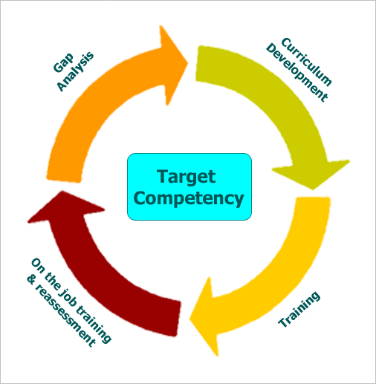
Training Process
Training process starts with the identification of Functional competency required to
perform a job effectively and efficiently.
An employee is assessed for her own set of skills and knowledge with reference to that of the
documented expectations of the position she is working.
Next step is to assess skills and knowledge gaps of the employee and/or groups within the
organisations. Subsequent training and development programmes are devised based
on gap analysis results.
This is followed by curriculum development and training and finally assessing the
effectiveness of the training imparted based on performance in the place of work.

Slide 121
Stress
Stress – a feeling of tension that occurs when a person assesses that a given situation is about to exceed his or her ability to cope and consequently will endanger his or her well-being.
Stress is the body’s automatic response - an unconscious mobilization of energy resources that occurs when the body encounters a stressor.
Acute stress – a short-term stress reaction to an immediate threat
Adrenaline is a chemical naturally produced in our body as a response to stress .
Chronic stress – a long-term stress reaction resulting from ongoing situations
Job stress - the feeling that one’s capabilities, resources, or needs do not match the demands of the job.

Slide 122
Key Definitions
Stressor –
environmental conditions that cause individuals to experience stress
Eustress –
positive stress that results from meeting challenges and difficulties with the expectation of achievement
Dystress –
negative stress; often referred to simply as stress. Often results in overload.
Job strain –
function of workplace demands and the control an individual has in meeting those demands.

Slide 123
Stress Management
There is no challenge without stress. It is a state of mind that drives individuals to take on difficult situations. The tendency to give up in difficult situations would make life too easy, uncomplicated and boring.
There are two ways of managing stress.
The first is that one should not allow stress to develop to the extent that one becomes non-functional.
The second is to develop a mechanism to get back to normal as quickly as one can and not to continue in a state of stress too long.

Slide 124
Individual Stress Management
Stress management at the individual level
Individual level planning to manage stress focuses on developing individual behavior that
helps in the elimination of sources of stress. It helps in developing a perspective to view
things that enables the person to cope with stress in a more effective manner.
Some of the steps are discussed below:
Exercise regularly
Practice healthy habits
Be realistic
Use systematic relaxation
Meditate
Develop and use planning skills
Simplify your life – Delegate
Take one thing at a time
Avoid unnecessary competition
Recognize and accept personal limits
Develop social support networks
Focus on enjoying what you do
Go easy with criticism
Take time off
Notes:
Exercise regularly. Twenty to 30 minutes of exercise per day benefits you physically and mentally.
Practice healthy habits. Get enough sleep. Eat a healthy diet. Avoid tobacco, caffeine, alcohol, and other drugs.
Be realistic. Understand your limits and be willing to say “no!”
Use systematic relaxation. Meditate. Engage in breathing exercises. Sit quietly and think of only pleasant things. Ten to 20 minutes of reflection can raise your resistance to chronic stress.
Develop and use planning skills. Planning can help you avoid stressors and figure out ways to cope with those you do encounter.
Simplify your life. Delegate. Get organized. Drop unnecessary and unpleasant activities.
Take one thing at a time. Avoid unnecessary overload. Don’t take work problems home. Don’t take home problems to work.
Avoid unnecessary competition. No one is always the best. Give in occasionally.
Recognize and accept personal limits. Drop the urge to be “superman” or “superwoman.” No one is perfect.
Develop social support networks. Research consistently shows that social support helps mitigate the effects of stress. Don’t try to cope alone.
Focus on enjoying what you do. Laugh!
Go easy with criticism. Go easy on yourself and others. Look for the positive. Research from the Mayo Clinic suggests that people with a positive outlook on life are healthier and live longer than those with a negative outlook.
Take time off. Go on vacation. Spend time everyday doing something you enjoy.

Slide 125
Organizational Stress Management
Increase individuals’ autonomy and control
Ensure that individuals are compensated properly
Maintain job demands/requirements at healthy levels
Ensure that associates have adequate skills to keep up-to-date with technical changes in the workplace
Increase associate involvement in important decision making
Improve physical working conditions
Provide for job security and career development
Provide healthy work schedules
Improve communication to help avoid uncertainty and ambiguity

Slide 126
Communication
Gender difference
In child hood, girls speak earlier than boys and at the age of three, have a vocabulary twice that of boys.
A woman speaks between 22,000 and 25,000 words a day whereas a man speaks between 7,000 and 10,000.
When a man talks, his speech is located in the left side of the brain but in no specific area. When a woman talks, the speech is located in both hemispheres and in two specific locations.

Slide 127
Communication
Communication is the process of sharing thoughts, ideas, and emotions with others, and
having those thoughts, ideas, and emotions understood.

Slide 128
Elements of communications
Needs a sender, a message, and a receiver for communication to take place

Slide 129
Process of Communication
communication is known as interpersonal, wherein the information or message is transferred from one person to the others.
Transmitting person of the message is called the sender or transmitter.
Receiver of message is called the receiver.

Slide 130
Encoding, Channel, Decoding
The process of converting information that has to be sent, into a format which the receiver can understand is known as encoding.
Information can be encoded into various formats – oral, written or visual. To show each of the formats we had to go through a medium called channel.
Information which is transferred to the receiver has to be interpreted. Interpretation is known as decoding. The process of replying is known as feedback.

Slide 131
Feedback
After sending the message, the sender becomes a receiver and the receiver becomes a sender through the process of feedback.
Feedback is the receiver's response to the attempt by the sender
The channel for feedback may be quite different from the original channel chosen by the sender.
A puzzled look may be the feedback to what the sender considered a perfectly clear oral instruction.

Slide 132
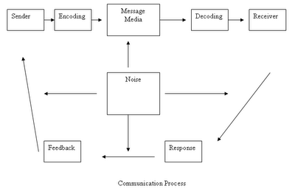

Slide 133
Communication Process
To send any message a sender chooses a suitable channel and finally receiver sends a message back to the sender.
Effect on the receiver is the result and completes the communication process

Slide 134
Methods of Communication
One Way-
Memo, Fax, email, letter
Two Way
Phone call, talking in person
Collaborative
Team meeting, consulting, Consensus

Slide 135
Speaker vs Receiver
“When we speak (or listen), our attention is focused on words rather than body language.
But our judgments ( as receiver) includes both. An audience is simultaneously processing both verbal and nonverbal cues.

Slide 136
Parts of face to face communication
Prof. Albert Mehrabian identified three major parts that convey meaning in human face to face communication:
body language,
voice tonality,
and words.

Slide 137
Face to face communications
55% of impact is determined by body language—
postures, gestures, and eye contact,
38% by the tone of voice, and
7% by the content or the words spoken.

Slide 138
Barriers to Effective Communication
In each process of communication – encoding, transference and decoding, there may be possibility of interference.
It may hamper the communication process. This is known as noise.
Barriers are also major difficulties during message transferred.
To ensure clarity in communication, barriers must be eliminated or minimized.

Slide 139
Barriers
Linguistic and cultural differences:
Words are not reality. Words as the sender understands them are combined with the perceptions of those words by the receiver.
Communication can be difficult if an employee does not understand the language or lingo (jargon) used in the office.
Using cliches or phrases in the office when communicating with employees who are not familiar with the phrases can result in tasks not being completed effectively.
In that situation sometimes the employee will feel if she asks what the lingo means, others will think she is not qualified for the job, so she decides not to ask questions.

Slide 140
Barriers
Muddled messages –
Effective communication starts with a clear message.
Contrast these two messages:
“ Please be here about 7:00 tomorrow morning.“
“ Please be here at 7:00 tomorrow morning."
The one word difference makes the first message muddled and the second message clear.

Slide 141
Barriers
Physical Barriers
Marked out territories,
Closed office doors, barrier screens, separate areas for people of different status
large working areas or working in one unit that is physically separate from others.

Slide 142
Barriers
Environment:
Noise is the basic barriers in the types of environment barriers of communication.
Regardless of the cause, interruptions are a barrier to communication

Slide 143
Barriers
Channel:
"Good morning." An oral channel for this message is highly appropriate.
Writing "GOOD MORNING!" on a blackboard in the class is less effective than a warm oral greeting.

Slide 144
Barriers
Lack of feedback –
Feedback is the mirror of communication. Feedback mirrors what the sender has sent. Feedback is the receiver sending back to the sender the message as perceived.
Without feedback, communication is one-way.

Slide 145
Barriers
Poor listening skills –
Listening is difficult. A typical speaker says about 125 words per minute. The typical listener can receive 400-600 words per minute.
Thus, about 75 percent of listening time is free time. The free time often sidetracks the listener.
The solution is to be an active rather than passive listener.

Slide 146
Barriers
Transmission Journey:
There can be some difficulties during transmission journey. So, it is necessary to repeat the massage and use more than one channel to communicate a message.

Slide 147
Barriers
Lack of Planning:
Purpose to communicate a person should be very clear. So, planning is the most effective thing to void lack of planning in communication.

Slide 148
Barriers
Semantic Distortion:
A single word conveys lots of different meanings.
Each word is understood in reference to the context of the sentence as well as place and situation it is used at.
Semantic Distortion can be deliberate or accidental.
When it is deliberate, it is intended so but the one that is accidental hinders the progress of communication.
It renders ambiguity to the message and every different individual may come to his own conclusion in the end.
Ex:- next slide

Slide 149
Semantic Barriers
Lack of common language
Poor vocabulary
Use of jargons
Poor grammar and punctuation
Round about verbiage
Lack of clarity in the message

Slide 150
Motivation
Motivation is derived from the Latin word ‘movere’ which means ‘to move’ or ‘to energize’ or ‘to activate’.
Motivation is a drive, an energizing force that directs and sustains a person’s effort to achieve a given objective and goal.
Motivation refers to all the internal conditions that stir up activity and sustain activity of an individual.

Slide 151
THEORIES OF MOTIVATION:
DRIVE THEORY / GOAL SETTING THEORY
EQUITY THEORY
incentive theories
Participation theory
maslow’s theory of human motivation

Slide 152
DRIVE THEORY:
This theory might be described as ‘push theory’ of motivation. Here, the behavior is “pushed” towards goals by driving states within a person.
When an internal driving state is aroused, the individual is pushed to engage in behavior which will lead to a goal that reduces the intensity of driving state.

Slide 153
GOAL SETTING THEORIES
Goal setting is recognized explicitly or implicitly by virtually every major theory of work motivation
the existence of goals in and of themselves can motivate behavior
people assigned difficult goals tend to perform better than those with moderately difficult to easy goals
the idea behind goal setting theory is that goals motivate people to compare current performance to performance needed to meet goals
it is better to state a specific goal than to simply urge people to do their best
goal setting has been found to enhance performance about 90 percent of the time

Slide 154
Equity Theories
equity theories are based on social exchange
People's expectations about what is fair or equitable are learned through the process of socialization -- and also comparison of their experiences with those of others
the “equity norm” suggest that those who contribute more to an organization should receive more rewards
people look to others to evaluate whether they think they are treated fairly

Slide 155
Equity Theories
motivation according to this model is a consequence of perceived inequity
perceived inequity creates tension in proportion to the magnitude of the inequity
people can either feel guilty because they think they are paid too much (overpayment inequity)
or be angry because they are paid too little (underpayment inequity)
individuals are motivated to reduce this tension by either changing what they do or changing what they think

Slide 156
INCENTIVE THEORY:
This is a model of human behavior suggesting that behavior is learned and that motivations and behavior can be changed by manipulating rewards and punishments
Incentive means the motivational value of a reinforcer.
In contrast with the push of drive theories, incentive theories are ‘pull theories of motivation. Because of certain characteristics they have, the goal objects pull behavior towards them.
Incentives can be
Positive incentives: wages, salaries, bonuses, vacations and the like.
Negative incentives: punishment, electric shock.

Slide 157
Participation As a Motivator
a participative approach is positively related to employee motivation and performance
this can be seen as a
Continuum from authoritarian to Democratic management of governance
Democratic systems management has complete confidence in trust and workers
workers are motivated by
participating in goal setting, development of reward, improving methods, and evaluating goal attainment

Slide 158
Maslow’s Theory of Motivation Human Needs
Maslow’s hierarchy of needs is a theory of psychology that contends each one of us is motivated by needs.
Maslow’s Needs states that we must satisfy each need in order, starting with the first, which deals with the most obvious needs of survival, food and shelter first.
Only when the lower order needs of physical requirements are met, people looks forward to satisfy the emotional needs, which fulfills the esteem and self-actualization needs..

Slide 159
Maslow’s Theory of Motivation Hierarchy of Needs
Self –Actualization Personal Growth & Fulfillment
Esteem Needs Achievement, Status, Responsibility, Reputation
Belongingness and Love needs Family, Affection, Groups, etc.
Safety Needs Protection, Security, Law & Order, Stability etc.
Biological and Physiological Needs Food, Water, Shelter, etc.

Slide 160
Job Satisfaction
Job satisfaction is an attitude which indicates how content an individual is with his or her job.
It is determined by a discrepancy between what one wants in a job and what one has in a job.
Five factors that can be used to measure and influence job satisfaction are:
Pay or total compensation
The work itself (such as projects, responsibilities)
Promotion opportunities (i.e., job enlargement, more prestigious title)
Relationship with supervisor
Interaction and work relationship with coworkers
Job satisfaction is a subjective construct representing an emotional feeling an individual has about the different facets of the job and their scales vary from person to person.

Slide 161
Job Satisfaction
Employee job satisfaction is both a function of the person and the job environment.
Some of the popular theories of Job Satisfaction are
Intrinsic/Extrinsic –
Intrinsic sources originate within the employee and have psychological value (i.e., challenging work, recognition, sense of accomplishment etc.)
Extrinsic sources originate outside of the employee (i.e., working conditions, relationships with co-workers, supervisors etc.)
Fulfillment theory –
Receiving more of something on the job is better
Discrepancy theory –
The perceived gap between what one wants from the job and what one perceives it is offering
Equity theory –
Perceived equity in the employee’s outcome/input ratio compared to others in the organization or in the society around him.

Slide 162
Job Satisfaction & Motivation
Herzberg argued that that it is the feelings of job satisfaction were more important than money for persuading people to contribute more and increase productivity.
Workers become dissatisfied when opportunities for meaningful achievement are lacking or eliminated.
Contemporary author Myers argued that when basic factors of job satisfaction were met by the worker, attempts should be made to take the satisfaction to another level by
job enlargement (making jobs more challenging and interesting by increasing variety) and
job enrichment (by providing greater growth opportunities).

Slide 163
What is a Team?
Performance of one team member is dependent upon the performance of another.
Teams utilize complementary skills and have a shared set of goals.
Team’s features include
A relatively small number of people
With complementary skills
Who are committed
To a common purpose,
Set of performance goals and approach
For which they hold themselves mutually accountable
Notes:
The tasks or activities that the team performs must be interdependent so that the Finally, team members hold themselves mutually accountable for performance.

Slide 164
Teams.
Interdependency, sharing leadership and mutual accountability are the hallmarks of a true team.
Teams:
Are characterized by interdependency
Often share leadership roles
Express individual and mutual accountability
Have specific team purposes that the team delivers
Have collective work products
Encourage open-ended discussions and active problem-solving at meetings
Measure performance against collective work products
Do real work together
Notes:
Sometimes the word “team” is used to describe a group. Some groups are similar to teams in that, like teams, they have a common purpose but they lack several essential characteristics.

Slide 165
Values of Teamwork
Effective teams operate with a
set of values that subordinates individual goals to the goals of the team.
These values are part of the normative framework of effective teams and enable the team to collaborate, make decisions and achieve their goals
Encourage listening and responding constructively to the views expressed by others
Give others the benefit of the doubt and provide support
Recognize the interests and achievements of others

Slide 166
Team Effectiveness
Critical prerequisites for building an effective team are interaction, mutual influence, interdependence and a well defined common goal.
However, forming a team cannot ensure success.
For a team to succeed, it is essential that members work consciously to maintain, build and develop effectiveness.
A critical factor in designing and developing a team is related to individuals who comprise the team. Team composition depends largely upon the mixture of individual inputs and the skills that are available in the team.
For a team to be effective each team member should be clear about their roles within it.
Member roles mainly fall into three broad categories-
task oriented,
relationship oriented, and
self-oriented.

Slide 167
Roles
Task-oriented roles:
The team member plays the role of an initiator, informer, summarizer, reality tester and consensus taker.
Relationship-oriented roles:
The team member takes on the responsibilities of a harmonizer, gatekeeper, encourager, compromiser, observer and commentator
Self-oriented roles:
The team member does not play the negative role of an avoider.
Effective teams are the ones that are able to integrate the relationship-roles and task-oriented roles well.
Team Effectiveness relates to achievement of well set and well defined objectives and goals.

Slide 168
Characteristics of Winning Teams-Team Effectiveness
Effective teams are characterized by several features.
Mutual Trust
Clear time frame and agreed upon goals
Get facts and do analyses before making decisions
Divide responsibilities
All team members contribute
Challenge and play devil’s advocate
Notes:
Team members trust one another. Trust allows team members to collaborate more effectively, make better decisions and take risks necessary to win.
Managing teams requires agreed upon goals. Every meeting held by the team should have clear goals and the time allocated for each decision should be clear to all team members.
Effective teams do not rely on "gut" intuition or feel in making decisions but instead gather information and facts
The complexity of projects demand division of responsibilities. While this division can be done in a variety of ways it is important that everyone's role is clear.
The team leader and other team members must make sure that all team members are playing a role and contributing.
Finally, Groupthink can be avoided by making sure that proposed decisions are challenged and that alternatives are considered.

Slide 169
Barriers to Team Effectiveness
Issues that can reduce the team effectiveness are:
Time taken by team to take decisions, if high may effectively take time away from working directly on the subject
Potential for increased conflict over decision making without adequate training and preparation
With out team leadership (as opposed to traditional top-down leadership) the teams will be unproductive
Individual resistance to work in a team.
Problems of ‘groupthink’ and pressure to conform.

Slide 170
Conflict
Conflict occurs when two people try to occupy the same "space" at the same time.
This space could range from a physical space, such as the last open seat on a crowded bus, to psychological space, in which each party believes that there are incompatibilities in what the various parties want.
Conflict thus can be defined as
an expressed struggle between at least two interdependent parties
who perceive incompatible goals, scarce resources, and interference from others in achieving their goals.

Slide 171
Conflict can be Desired
Earlier concept was that conflict was "bad" ...something to be avoided and, if present, to be "resolved."
But modern days concept is that conflict has functionality - that it can have both positive and negative effects.
This view led to the present state of calling the field "conflict management," rather than conflict resolution.
It is easy to identify potential negative consequences of conflict.
Potential Positive effects of conflict,
e.g.: conflict can cause problems to surface and be dealt with, clarify varying points of view, stimulate and energize individuals, motivate the search for creative alternatives, and provide a mechanism for adjusting relationships in terms of current realities.
Properly managed, conflict can help to maintain an organization of vigorous, resilient, and creative people.
The goal of conflict management, then, is to increase the positive results, while reducing the negative ones.

Slide 172
Views on Conflict
Traditional View
All conflicts are harmful and must be avoided
Human Relations view
That believe that conflict is a natural and inevitable outcome in any group.
Integrationist’s view
They believe that conflict is not only a positive force in a group but it is absolutely necessary for a group to perform effectively.

Slide 173
Conflict Management
Conflict Management is defined as the opportunity to improve situation and strengthen relationships.
Conflict management is the process of limiting the negative aspects of Conflict while increasing the positive aspects of conflict.
The aim of conflict management is to enhance learning and group outcomes, including effectiveness or performance in organizational setting.
Properly managed conflict can improve group outcomes

Slide 174
Steps in Managing Conflict
Conflict can be effectively managed in three steps
Define conflict and get concerned about it when it is at latent or felt stage
Identify the root causes behind conflict by diagnosis and analysis
Work out an implementable and acceptable management strategy through negotiations.
One has to accept the fact that conflict is inevitable in any human group and therefore positive steps need to be taken to resolve it.
There is a need to play the role of a leader in the group to bring consensus in identifying the various issues involved in a conflict.
The issues involved should be discussed openly with the stakeholders and each has to tackled at a time.
Tackling one issue at a time helps in addressing complicated problems systematically and arriving at a long lasting solutions.

Slide 175
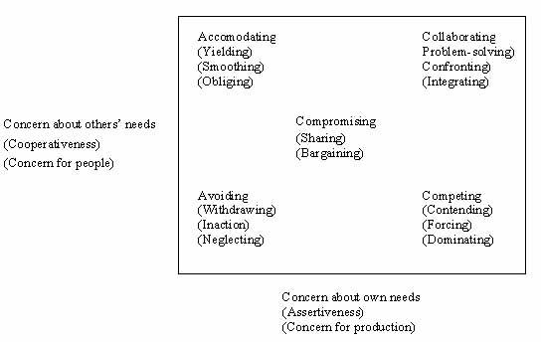
Conflict Management Strategies

Slide 176
Conflict Management Strategies
Competing orientation or response mode involves an emphasis on winning one's own concerns at the expense of others' concerns -- to be highly assertive (often aggressive) and uncooperative.
Accommodating is both unassertive and cooperative, concentrating on trying to satisfy the other's concerns with little attention to (or even at the expense of) one's own concerns. It includes appeasement, yielding to the other, and acquiescing.
Collaborating is a mode with great emphasis on satisfying the concerns of all parties--to work with the other party cooperatively to find an alternative that integrates and fully satisfies the concerns of all. This mode is both assertive and cooperative.
Avoiding reflects inattention to the concerns of either party--a neglect, withdrawal, indifference, denial, or apathy. It is neither assertive nor cooperative.
Compromising (sharing or bargaining) is intermediate in both assertiveness and cooperativeness.

Slide 177
Managerial Grid Model
Conflict Management Strategies lead to different behavioral leadership model of managers, which are discussed below.
Managerial grid model
The Managerial Grid Model (1964) is a behavioral leadership model developed by Robert Blake and Jane Mouton. This model identifies five different leadership styles based on the concern for people and the concern for production. The optimal leadership style in this model is based on Theory Y.
The model is represented as a grid with concern for production as the X-axis and concern for people as the Y-axis; each axis ranges from 1 (Low) to 9 (High). The five resulting leadership styles are as follows:

Slide 178
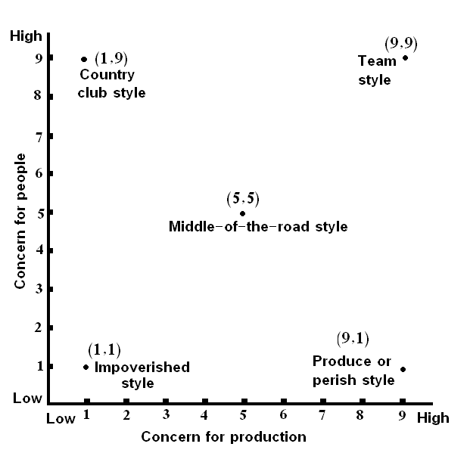
Managerial Grid

Slide 179
Managerial Grid
Country Club Leadership – High People/Low Production
This style of leader is most concerned about the members of his/her team under the assumption that as long as team members are happy and secure they will work hard. But what tends to result is a work environment that is very relaxed and fun but production tends to suffer due to lack of direction and control.
Produce or Perish Leadership – High Production/Low People
Also known as Authoritarian or Compliance Leaders, people in this category believe that employees are simply a means to an end. This type of leader is very autocratic, has strict work rules, policies, and procedures, and views punishment as the most effective means to motivate employees.

Slide 180
Managerial Grid
Impoverished Leadership – Low Production/Low People
This leader is self centric and concerned about himself only and rather than the organization. The result is a place of disorganization, dissatisfaction and disharmony.
Middle-of-the-Road Leadership – Medium Production/Medium People
This style seems to be a balance of the two competing concerns. It may at first appear to be an ideal approach. But it results in compromise where both concerns have to be compromised, which makes neither production nor people needs are fully met. Leaders who use this style settle for average performance and often believe that this is the most anyone can expect.
Team Leadership – High Production/High People
According to the Blake Mouton model, this is the pinnacle of managerial style. These leaders stress production needs and the needs of the people equally highly. The premise here is when employees are committed to, and have a stake in the organization’s success, their needs and production needs coincide. This creates a team environment based on trust and respect, which leads to high satisfaction and motivation and, as a result, high production.

Slide 181
Management :-An Art or Science?
Management is not yet comparable to exact science like Ph, Ch, Maths, since management deals with complex human beings, whose behavior is ever changing and is unpredictable
Mary Follet first defined management as an art. She put forward the view that the Principles of Management is not a fundamental truth, even though there is an existence of a sound body of knowledge evolved out of careful observations. Until the human behavior can be completely known, management principles should be carefully supplemented with sound business judgment.

Slide 182
Creativity
Creativity is a function of knowledge, curiosity, imagination, and evaluation. The greater the knowledge base and level of curiosity, the more ideas, patterns, and combinations can be achieved,
which then correlates to creating new and innovative products and services.
Business creativity is the entire process by which ideas are generated, developed and transformed into value.
It includes both the art of innovating new ideas and the discipline of shaping and developing those ideas to the stage of realized value.
In these times of shifting competitive dynamics, technological change, demographic shifts and capricious consumer tastes, no business is safe unless it reinvents itself continuously.

Slide 183
Creativity and Innovation
Creativity refers to generating new and novel ideas.
Innovation refers to the application of an idea and, in many cases, is a collaborative enterprise.
So in other words, innovation is applied creativity.
Creativity is starting point for innovation
Former necessary but not sufficient for latter.

Slide 184
Entrepreneurship
An entrepreneur always seeks change, responds to it and exploits it as an opportunity. The entrepreneur has a mindset that sees the possibilities than the problems created by change.
The heart of entrepreneurial management as the pursuit of opportunity without regard to resources currently controlled.
Attitude of a successful entrepreneur
A successful entrepreneur need to
Take fear out of failure
Have a worthy goal
Never give up
Be ready to work-life imbalance
Believe in your vision
Be ready to change course, if the need arises.

Slide 185
Entrepreneurship and Creativity
Entrepreneurs need to be creative in their attempts. Creativity begins with the generation of ideas.
The ideas need to be creative enough to entice the society to pay more than its cost. This demands creative ideas to be translated at the work place in selecting, developing and implementing ideas.
The highest form of art is perhaps business. It is an extremely creative form and can be more creative than all the things we classically think of as creative.
In business the tools with which an entrepreneur works are dynamic. They are man, machine and the process, market and the capital.
Taking these tools and reorganizing them creatively to create value which others cannot, can only give the entrepreneur the necessary edge over its competitions.
With the environment and the competitive forces undergoing continuous change it is the creative ingenuity of the entrepreneur which takes him to the path of success.

Slide 186
Module 3
Leadership
Decision Making
Financial Ratios
Statistical Inference & SQC

Slide 187
Leadership
Leadership has been described as "a process of social influence in which one person can enlist the aid and support of others in the accomplishment of a common task.“
Leadership is not only the ability to get the work done with and through others, but also to coin their confidence, respect, loyalty and willing co-operations at the same time.
Leadership is congruent with self-expression that requires clarity, consciousness and courage to create value.
There are various theories that define leadership such as
Traits theory
Behavioral model of leadership
Situational approach

Slide 188
Leadership Traits
The assumption that leadership is rooted in the characteristics that certain individuals possess as personal attributes is known as the “trait theory of leadership”.
It focuses on a set of individual attributes such as
Integrity: Commitment to the highest personal and professional standards. This builds trust and confidence among followers.
Develop a winning strategy: Leaders have to be clear on what the organization does best and build upon it.
Build a great team: Good leaders build a great team around them with complementary skills and experiences.
Inspire people around them: Leaders communicate constantly and listen attentively, carefully and intensively; encourage risk taking and even failures as learning experience.
Commitment: Devotion to duty and purpose
Energy: Enthusiasm and drive to take and lead by examples.
Decisiveness: Willingness to act
Selflessness : Prepared to sacrifice personal objectives for the team and the organizational objectives.

Slide 189
Leadership Traits of Business Leaders
Honesty
The business and its employees are a reflection of the leader’s self, and if he makes honest and ethical behavior a key value, the team will follow suit.
Ability to Delegate
Delegating tasks to the appropriate departments is one of the most important skills a business leader should have. The key to delegation is identifying the strengths of his team, and capitalizing on them.
Communication
Being able to clearly and succinctly describe the vision to the team members is an essential trait of a business leader. This is necessary to build trust.
Sense of Humor
Morale is linked to productivity, and it is the leader’s job to instill a positive energy. . Encourage team to laugh at the mistakes instead of crying.
Confidence
Leader’s role is to keep up the confidence level, and assure everyone that setbacks are natural and the important thing is to focus on the larger goal.
Commitment
Leader’s role is not only to show his commitment to the work at hand, but also to his promises.
Creativity
Leader must have creativity as an essential trait, since business situation are often volatile and leaders at times need to deviate from the set course and make an on the fly decision. This helps leading a team through uncharted waters.

Slide 190
Behavioral Model of Leadership
The behavioral model focuses on what leaders do and how they do it.
It focuses on specific attitudes of leaders, implying thereby that leadership can be taught.
According to this model, programs that inculcate specific leadership traits can be designed and imparted to individuals who would like to become effective leaders.
Some may share Task-centered relations with employees, whereas others may have a Considerate and supportive relationship providing work environment for job satisfaction, promotion or recognition as motivators to foster efficiency.

Slide 191
Situational Approach
This approach claims that while some traits are common across a number of studies,
but the overall evidence suggests that persons who are leaders in one situation may not necessarily be successful as leaders in other situations.
This gives the emergence of an alternate leadership theory which claims that leadership cannot be characterized as an enduring individual trait.
The Situational approach posited that individuals can be effective in certain situations, but not in others.
It is a contingency theory, which focuses on the followers; according to this what matters is selecting the right style of leadership in a given situation, depending on the level and degree of preparedness on the part of the followers.
In this theory, it considers the adaptability is the key and the successful leaders adapts his/her behavior according to the situations.

Slide 192
Decision Making
There are two basic types of decisions, namely Programmed Decision and Non-programmed decisions.
Programmed decisions are routine and repetitive; certainty in cause-and-effect relationship. Decisions can be taken based on laid down policies, rules and regulations and are taken at a junior management levels of the organization.
Non-programmed decisions are one shot occurrences and are usually less structured.
Decision making is a cognitive process of selecting a course of action from among multiple alternatives.
Non-programmed decisions are important, difficult and therefore demand creative problem-solving approaches. Such decisions are generally taken at the senior management level.

Slide 193
Decision making steps
Identify the decision to be made: After realizing that a decision must be made, you then go through an internal process of trying to clearly define the nature of the decision you must make.
· Gather relevant information: Most decisions require collecting pertinent information. Some information must be sought from within yourself through a process of self-assessment, while other information must be sought from outside books, people and a variety of other sources.
· Identify alternatives: Through the process of collecting information you will probably identify several possible paths of action, or alternatives. In this step of the decision-making process, you will list all possible and desirable alternatives.
· Weigh evidence: In this step, you draw on your information and emotions to imagine what it would be like if you carried out each of the alternatives to the end. You must evaluate whether the need identified in Step 1 would be helped or solved through the use of each alternative.
· Choose among alternatives: Once you have weighed all the evidence, you are ready to select the choice that seems to be best suited to you.
· Take action: You now take some positive action, which begins to implement the alternative you chose.
· Review decision and consequences: In the last step you experience the results of your decision and evaluate whether or not it has "solved" the need you identified in Step 1. If it has, you may stay with this decision for some period of time. If the decision has not resolved the identified need, you may repeat certain steps of the process in order to make a new decision.-

Slide 194
Decision-making tools and techniques
Decision matrix: A decision matrix is used to evaluate all the options of a decision. When using the matrix, create a table with all of the options in the first column and all of the factors that affect the decision in the first row. Users then score each option and weigh which factors are of more importance. A final score is then tallied to reveal which option is the best.
T-Chart: This chart is used when weighing the plusses and minuses of the options. It ensures that all the positives and negatives are taken into consideration when making a decision.
Decision tree: This is a graph or model that involves contemplating each option and the outcomes of each. Statistical analysis is also conducted with this technique.
Multi-voting: This is used when multiple people are involved in making a decision. It helps whittle down a large list options to a smaller one to the eventual final decision.
Pareto analysis: This is a technique used when a large number of decisions need to be made. This helps in prioritizing which ones should be made first by determining which decisions will have the greatest overall impact.
Cost-benefit: This technique is used when weighing the financial ramifications of each possible alternative as a way to come to a final decision that makes the most sense from an economic perspective.
Conjoint analysis: This is a method used by business leaders to determine consumer preferences when making decisions

Slide 195
Various models of decision-making
Various views and theories of decision-making may be found in the literature. The following list of views, supporting theories and models is based upon categorizations provided by Keen and Scott Morton (1978), Huber (1981), and Das and Teng (1999).
The rational model
The rational manager view assumes a rational and completely informed decision-maker who is an “economic man”. He takes decisions to maximize gains (profit) or to minimize loss (cost). The process of rational decision-making comprises a number of steps. They are :
• Intelligence: finding occasions for making a decision;
• Design: inventing, developing and analyzing possible alternative courses of action;
• Choice: selecting a particular course of action from those available; and
• Review: assessing past choices.

Slide 196
The Rational Model contd..
In classical or perfect rationality, methods of decision analysis are used to attach numerical values or utilities to each of the alternatives during the “choice” phase.
The alternative with the highest utility (or maximum subjective expected utility) is selected.
When using the rational model in this fashion, it is assumed that managers know of :
• all possible alternatives;
• the consequences of implementing each alternative;
• have a well organized set of preferences for these consequences; and
• have the computational ability to compare consequences and to determine which is preferred

Slide 197
Decision Making Tools
Various tools and techniques are being used in decision making so that the problem situation is scientifically diagnosed and analysed. Some of them are
Pareto Analysis
This is a simple technique which brings out an important principle of VITAL FEW : TRIVIAL MANY. Statistics reveal that just 20% of work can generate 80% of the advantage required for doing the entire job.
Paired Comparison Analysis
It is helpful in working out the relative importance of a number of available choices. It helps the decision maker to prioritize the conflicting demands on available resources. It is more used where objective data for decision making is not available.
Grid analysis
It is used when a decision maker has a number of good alternatives and many other factors to take into account. The relative importance of each factor in a given problem situation is marked by assigning weights according to their increasing or decreasing importance in a scale of say 1-5 or 1-10. (In case of difficulty in assigning weights, one can use paired comparison). Weighted scores are calculated by multiplying the scores with the values of relative importance in terms of the assigned weights assigned to each factors. Highest scores is chosen.
PMI
PMI stands for Plus/minus /implications. For every action, positive results are recorded under Plus and negative results under Minus and finally the resultant effects under Implications. This process helps to determine whether to implement a decision or not.
Decision Tree
Decision Tree is a powerful means of depicting and facilitating the analysis of important problems, especially those that involve sequential decisions and variable outcomes over time.

Slide 198
Decision Theory Models
Decision theory problems are generally represented as one of the following:
Influence Diagram
Payoff Table
Decision Tree

Slide 199
Influence Diagrams
An influence diagram is a graphical device showing the relationships among the decisions, the chance events, and the consequences.
Squares or rectangles depict decision nodes.
Circles or ovals depict chance nodes.
Diamonds depict consequence nodes.
Lines or arcs connecting the nodes show the direction of influence.

Slide 200
Payoff Tables
The consequence resulting from
a specific combination of a decision alternative and
a state of nature.
is a payoff
A table showing payoffs for
all combinations of decision alternatives and
states of nature is a payoff table.
Payoffs can be expressed in terms of profit, cost, time, distance or any other appropriate measure.

Slide 201
Decision Tree
Decision Tree, also called Decision Flow Networks and Decision Diagrams, are powerful means of depicting and facilitating the analysis of important problems, especially those that involve sequential decisions and variable outcomes over time.
Decision Trees are used in practice because
they make it possible to breakdown a large, complicated problem into a series of smaller simple problems,
and
they enable objective analysis and decision making that includes explicit consideration of the risk and effect of the future.
The name Decision Tree is appropriate, because it shows branches for each possible alternative for a given decision and for each possible outcome that can result from each alternative.
It helps to reduce abstract thinking to a logical visual pattern of cause and effect.

Slide 202
Decision Trees
Three types of “nodes”
Decision nodes - represented by squares (□), where decisions have to be made
Chance nodes - represented by circles (Ο), where circles denote different possible outcomes
Terminal nodes - represented by triangles ( this is optional)
Solving the tree involves pruning all but the best decisions at decision nodes, and finding expected values of all possible states of nature at chance nodes. Pruning is represented by
Process followed
Create the tree from left to right
Solve the tree from right to left
Pruned Branch

Slide 203
Example Decision Tree
Chance
node
Event 1
Decision
node
Event 2
Decision 1
Event 3
Decision 2

Slide 204
Decision Making Process
The branches leaving each round node represent the different states of nature
While the branches leaving each square node represent the different decision alternatives.
At the end of each limb of a tree are the payoffs attained from the series of branches making up that limb.

Slide 205
Mary’s Factory
Mary is a manager of a gadget factory. Her factory has been quite successful the past three years. She is wondering whether or not it is a good idea to expand her factory this year. The cost to expand her factory is $1.5M. If she does nothing and the economy stays good and people continue to buy lots of gadgets she expects $3M in revenue; while only $1M if the economy is bad.
If she expands the factory, she expects to receive $6M if economy is good and $2M if economy is bad.
She also assumes that there is a 40% chance of a good economy and a 60% chance of a bad economy.
(a) Draw a Decision Tree showing these choices.

Slide 206
Decision Tree Example
.4
40 % Chance of a Good Economy
Profit = $6M
Expand Factory
Cost = $1.5 M
.6
60% Chance Bad Economy
Profit = $2M
Decision Alternatives
.4
Good Economy (40%)
Profit = $3M
Don’t Expand Factory
Cost = $0
.6
Bad Economy (60%)
Profit = $1M
NPV_{Expand} = (.4(6) + .6(2)) – 1.5 = $2.1M
NPV_{No Expand} = .4(3) + .6(1) = $1.8M
$2.1 > 1.8, therefore you should expand the factory

Slide 207
National Income Accounting
National Income Accounting is a set of principles and methods, that are used to measure the income and production of a country.
The purpose of National Income Accounting is to obtain some measure of the performance of the aggregate economy.
There are basically two ways of measuring national economic activity:
as the money value of the total production of goods and services during a given period (usually a year) or
as the total of incomes derived from economic activity after allowance has been made for capital consumption.

Slide 208
GNP as a measure
The most commonly used indicator of national output is the Gross National Product (GNP), which is a measure of the total market value of currently produced finished goods and the value of services rendered.
This excludes Intermediate products and replacement investment in capital goods.
But includes profits earned by nation’s business corporation’s foreign operations and earnings of workers working abroad.
Determination of market value of the goods and services is difficult and somewhat imprecise. Nonetheless the use of a common basis of valuation makes it possible to obtain a total that fairly represents the level of output of a country.
The rule that only currently produced goods and services should be counted ensures that only production occurring in the course of a given year is included

Slide 209
GDP vs. GNP
GDP (or Gross Domestic Product) and GNP (Gross National Product) measure the size and strength
of an economy but are calculated and used in different ways.
Comparison chart
 | GDP | GNP
Stands for | Gross Domestic Product | Gross National Product
Definition | An estimated value of the total worth of a country’s production and services, within its boundary, by its nationals and foreigners, calculated over the course on one year. | An estimated value of the total worth of production and services, by citizens of a country, on its land or on foreign land, calculated over the course on one year.
Formula for Calculation | GDP = consumption + investment + (government spending) + (exports − imports). | GNP = GDP + NR (Net income inflow from assets abroad or Net Income Receipts) - NP (Net payment outflow to foreign assets).
Uses | Business, Economic Forecasting. | Business, Economic Forecasting.

Slide 210
GNP vs NNP
Gross National Product [GNP] is the gross value of all the final products without deducting the depreciation of fixed capital. It is the total of market value of final goods and services produced in a year. Net National Product [NNP] is the value of net output in an economy during a period of one year. The net national product is calculated by deducting depreciation from the gross national product. NNP = GNP - Depreciation

Slide 211
Income Approach vs Expenditure Approach
GDP is generally understood to represent the health of a nation’s economy, and most people realize that if GDP is growing, things are going well, while if it’s falling things have turned sour in the economy. But what, precisely, does GDP measures? There are two primary methods for measuring GDP, which should yield the same result even though they measure completely different factors.
The income approach: measures the total incomes earned by households in a nation in a year.
The expenditure approach: measures the total amount spent on the goods produced by a country in a year.
Notes:
The INCOME APPROACH calculates GDP on the basis of the sum total of all payments (income) received by various economic agents engaged in different production activities. Thus, firstly, it includes the wages and salaries (W) of individuals engaged in gainful employment in public or private institutions including social benefits as also those that are self-employed.
Secondly, it includes the interest income (I) received by lenders of capital particularly financial capital. Any interest that you pay on your bank loan forms a part of interest income for the bank. As a corollary, any interest that you receive on your bank deposits also forms a part of interest income since you are the lender of financial capital to the bank.
The third component is the rent (R) earned by owners of land, usually called unearned income since it is not through any gainful employment.
Finally, the profits or losses (P/L) that accrue to the producers/entrepreneurs forms the last component. It should be noted that while profits add to the GDP (+), losses similarly DEDUCT from the GDP (-).
Thus, Y = W + I + R +/- P/L

Slide 212
Financial & Economic Analysis
The main goal of financial analysis (FA) is to examine the financial returns to Production projects.
This is aimed at demonstrating that all actors have enough financial incentive to participate.
Economic Analysis (EA) is carried out to assess the projects efficiency in terms of its net contribution to the national economic and social welfare.

Slide 213
Financial & Economic Analysis
Financial and Economic Analysis (FEA) of investment projects is
an appraisal requirement of most governments and International Financing Institutions (IFIs).
It provides the grounds for making decisions on investment financing a proposed project based on its financial and economic viability.

Slide 214
Financial & Economic Analysis
The core of financial and economic analysis is to put a monetary value on costs and benefits.
Costs are usually known, but some benefits may not have a price, and can be difficult to value (= "non-tangible"). This is the case of many projects, notably in the social sectors.
Cost - Benefit analysis is used to value projects with tangible benefits; and
Cost – Effectiveness analysis to analyse projects with non- - tangible benefits.

Slide 215
Projects are mix of Financial and Non-financial Benefits
In no case should one assume that because some benefits are non-tangible, no financial and economic analysis is possible.
As most projects include a mixture of tangible and non-tangible benefits, both types of analyses should normally be done.

Slide 216
Goals of Financial management
Primary goal of the Financial Management is to maximize the wealth of the company’s shareholders (owners) by increasing the market value (price) of their shares
This may at times may conflict with
social / ethical goals (for example, fair market operations, pollution control compliance etc.)
interests of the executive managements (for example, denying short-term compensation etc.)
Financial management’s role is to maintain a balanced financial health of the organization, so that it can service the borrowings in an appropriate manner to create goodwill with the lenders and to reduce the cost of future borrowings, if required.
Financial management also helps building market goodwill through attractive returns to the investors at an acceptable level of risk.

Slide 217
Functions of Finance
Routine Functions:
Cash management(receipt and disbursement of funds)
Credit management
Inventory control
Short-term financing
Exchange and interest rate hedging
Bank relations
Intermittent Functions:
Leasing
Stock issues
Capital budgeting
Dividend decisions
Long and medium term financing, where the objective is to
raise funds for the firm at minimal cost and acceptable risk
invest those funds in company assets so as to earn an attractive return given acceptable risks

Slide 218
Balance Sheet
A financial statement that summarizes a company's assets, liabilities and shareholders' equity at a specific point in time. Balance Sheet is the snap shot of financial strength of any company at any point of time. It must follow the following formula:
Assets = Outside Liabilities + Shareholders' Equity
It's called a balance sheet because the two sides balance out. This makes sense:
a company has to pay for all the things it has (assets)
by
either borrowing money (liabilities) or getting it from shareholders (shareholders' equity).
Accounts such as cash, inventory and property are on the asset side of the balance sheet, while on the liability side there are accounts such as accounts payable or long-term debt, apart from the share holder’s money (equity).

Slide 219
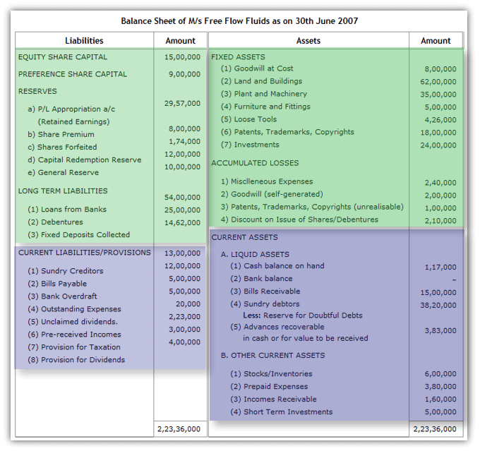
Sample Balance Sheet

Slide 220
Income Statement
The income statement is the one of the three major financial statements. The other two are the balance sheet and the statement of cash flows.
This measures a company's financial performance over a specific accounting period.
Financial performance is assessed by giving a summary of how the business incurs its revenues and expenses through both operating and non-operating activities.
Financial performance is for a time period, which is specified in its heading. The period of time that the statement covers is chosen by the business and will vary. For example, the heading may state:
"For the Three Months Ended December 31, 2012" (The period of October 1 through December 31, 2012.)
"The Financial Year Ended 31stMarch, 2013" (The period of April 1, 2012 through 31st March, 2013.)

Slide 221
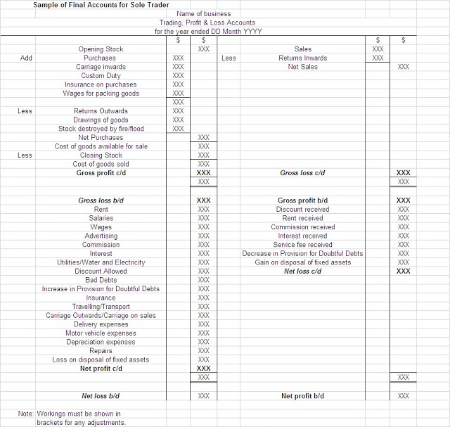
Sample Trading, Profit & Loss Account

Slide 222
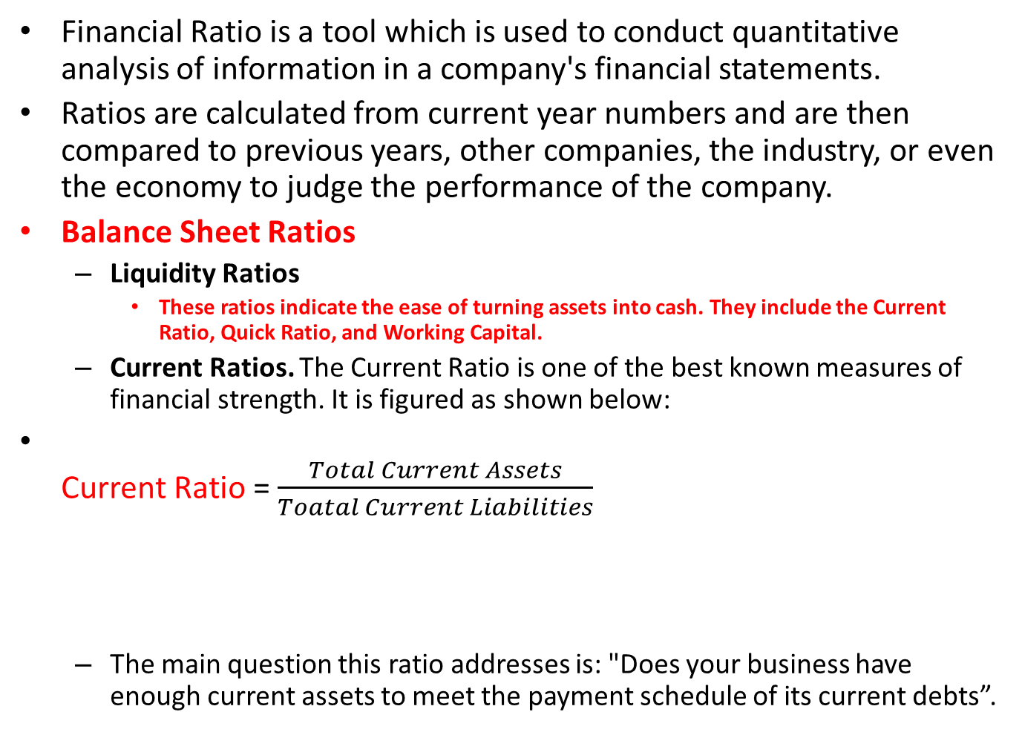
Financial Ratios
Financial Ratio is a tool which is used to conduct quantitative analysis of information in a company's financial statements.
Ratios are calculated from current year numbers and are then compared to previous years, other companies, the industry, or even the economy to judge the performance of the company.
Balance Sheet Ratios
Liquidity Ratios
These ratios indicate the ease of turning assets into cash. They include the Current Ratio, Quick Ratio, and Working Capital.
Current Ratios. The Current Ratio is one of the best known measures of financial strength. It is figured as shown below:
Current Ratio = $\frac{Total Current Assets}{Toatal Current Liabilities}$
The main question this ratio addresses is: "Does your business have enough current assets to meet the payment schedule of its current debts”.
Current Assets include Stock,
Short term investments, Debtors,
Receivables, Bank & Cash Account, etc.
Current Liabilities include Creditors,
Outstanding wages/salaries and other expenses,
Bank overdrafts etc.

Slide 223
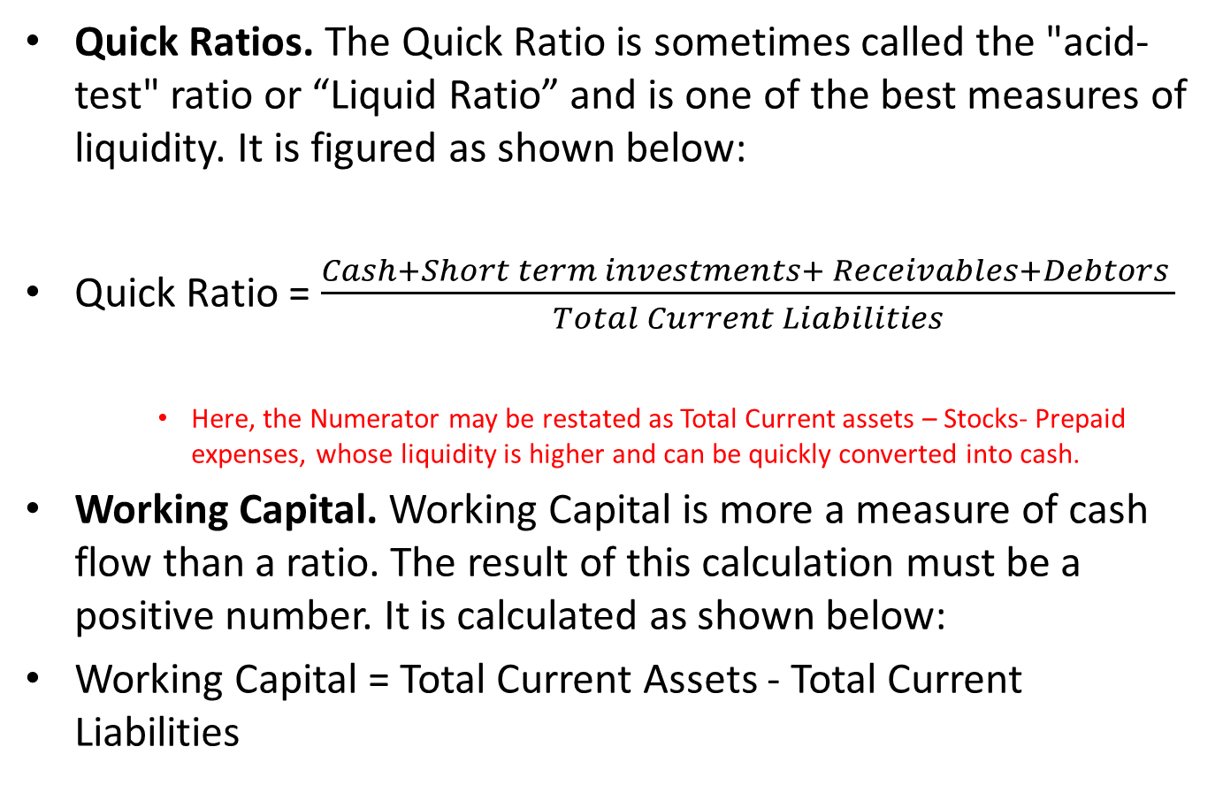
Financial Ratios
Quick Ratios. The Quick Ratio is sometimes called the "acid-test" ratio or “Liquid Ratio” and is one of the best measures of liquidity. It is figured as shown below:
Quick Ratio = $\frac{Cash+Short term investments+ Receivables+Debtors }{Total Current Liabilities}$
Here, the Numerator may be restated as Total Current assets – Stocks- Prepaid expenses, whose liquidity is higher and can be quickly converted into cash.
Working Capital. Working Capital is more a measure of cash flow than a ratio. The result of this calculation must be a positive number. It is calculated as shown below:
Working Capital = Total Current Assets - Total Current Liabilities

Slide 224
Debt-Equity Ratio
It is the relationship between borrower’s fund (Debt) and Owner’s Capital (Equity).
Long Term Outside Liabilities / Tangible Net Worth
Liabilities of Long Term Nature
Total of Capital and Reserves & Surplus Less Intangible Assets, if any.
For instance, if the Firm is having the following :
Capital = Rs. 200 Lacs
Free Reserves & Surplus = Rs. 300 Lacs
Long Term Loans/Liabilities = Rs. 800 Lacs
Debt Equity Ratio will be => 800/500 i.e. 1.6 : 1

Slide 225

Debt-Equity Ratio
Debt-Equity Ratio =$\frac{Total Long term Debts}{Shareholders^{′}Funds}$
Shareholders’ funds to include Equity Share capital, P&L A/C –Credit Balance as P&L Reserve and General Reserves and Surplus
From the Shareholders’ Funds deductions should be made for P&L Debit Balance/ Fictitious Assets.
Problem Sum
10,000 Equity shares @ $10 each. | 1,00,000
General reserve | 45,000
Accumulated profit | 30,000
Debentures | 75,000
Sundry trade creditors | 40,000
Outstanding expenses | 10,000
Solution:
Debt-Equity Ratio = Total long term debts / Shareholders funds
= 75,000 / 1,00,000 + 45,000 + 30,000 = 3 : 7
Every three dollars of long-term debts are being backed by an investment of seven
dollars by the owners. Thus the safety margin for creditors is more than double.

Slide 226
Problem sum on Ratio Analysis
LIABILITIES |  | ASSETS
Capital | 300 | Plant & Equipment | 65
General Reserves | 55 | Land & Building | 200
P & L Credit Balance | 7 | Cash | 1
Loan From S F C | 65 | Bills Receivables | 100
Debentures | 35 | Government Bonds | 25
Bank Overdraft | 38 | Stocks | 128
Sundry Creditors | 26 | Prepaid Expenses | 1
Provision of Tax | 9 | Goodwill | 30
Proposed Dividend | 15
 | 550 |  | 550

Slide 227
Answer
What is the Current Ratio ?
Ans : (125 +128+1+1) / (38+26+9+15)
= 255/88
= 2.89 : 1
Q What is the Quick Ratio ? Ans : (125+1)/ 88 = 1.43 : 1
Q. What is the Debt Equity Ratio ? Ans : LTL / Tangible NW
= 100 / ( 362 – 30)
= 100 / 332 = 0.30 : 1

Slide 228

Other Ratios
Debt Ratio= $\frac{Total Debts }{Total Assets}$
Debt Ratio shows the overall Debt burden of the company.
It is a financial ratio that indicates the percentage of a Company’s Assets that are provided via Debt.
It is the ratio of total debt (Long term Liabilities) and Total Assets (the sum of Current Assets, Fixed Assets, and other assets such as Goodwill). Here Outstanding expenses are normally excluded from the Outside Liabilities.
Example : Calculate debt ratio for PQR, Inc. based on the information given below
Current assets | 500,000
Non-current assets | 845,000
Non-current liabilities | 340,000
Current liabilities | 270,000
Accounts payable | 20,000
:Solution
Total assets = $500,000 + $845,000 = $1,345,000
Total debt = $340,000 + ($270,000 – $20,000) = $590,000
Please note that we excluded accounts payable from total liabilities because it is a liability but not debt funded by Creditors.

Slide 229

Inventory Turnover Ratio
Inventory Turn Over Ratio=$\frac{Cost of Goods sold}{Average Inventories (Average of Opening and Closing Stock)}$
Cost of Goods sold= Opening stock+ Cost of Goods Manufactured - Closing stock
Example: Calculate inventory turnover and days inventories outstanding for ABC, Inc. based on the information given below:
Opening inventories | $25,000
Closing inventories | $30,000
Cost of goods manufactured | $245,000
Solution
Cost of goods sold = $25,000 + $245,000 – $30,000 = $240,000
Average inventories = ($25,000 + $30,000) ÷ 2 = $27,500
Inventory turnover ratio = $240,000 ÷ $27,500 = 8.73
Days inventories outstanding = 365 ÷ 8.73 = 41.8 days

Slide 230
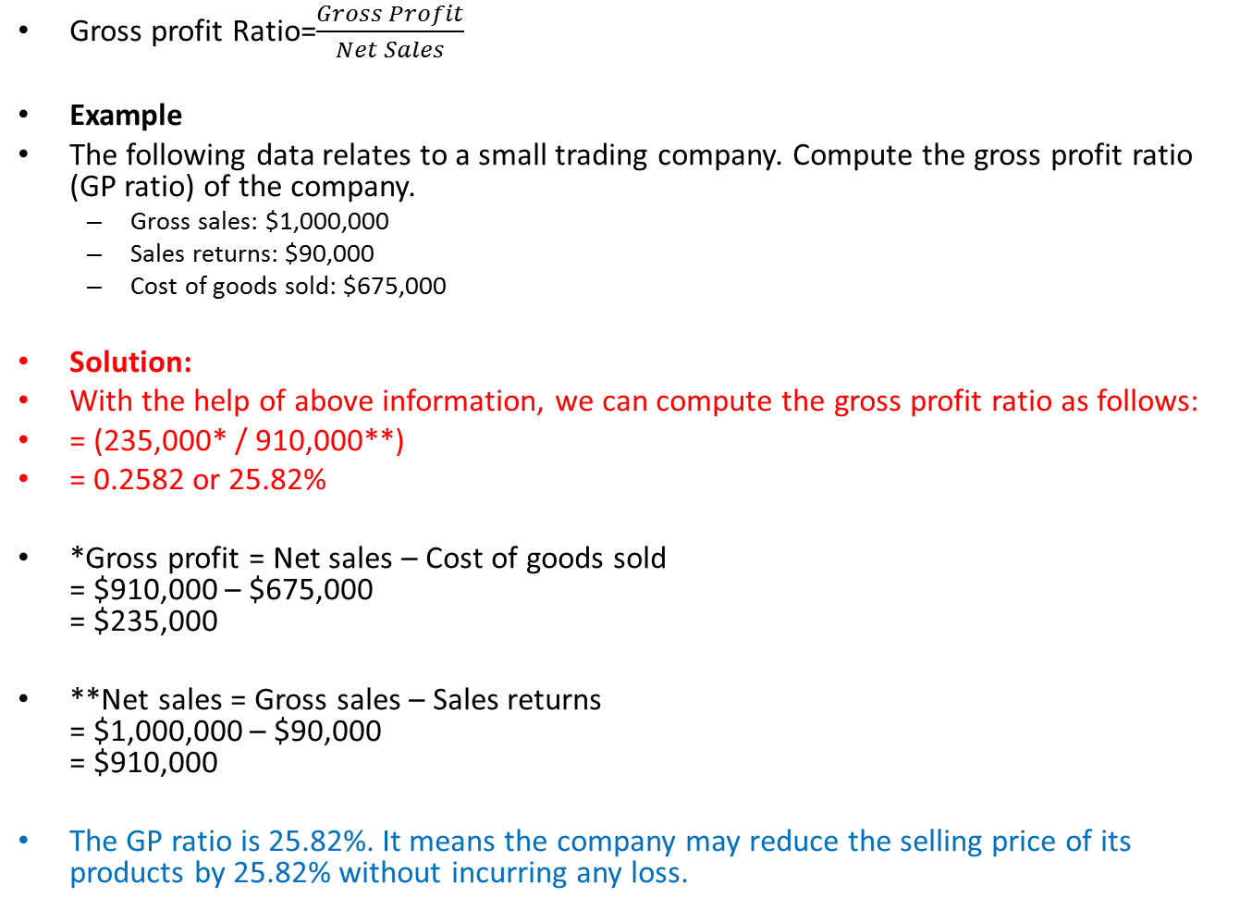
Gross Profit Ratio
Gross profit Ratio=$\frac{Gross Profit}{Net Sales}$
Example
The following data relates to a small trading company. Compute the gross profit ratio (GP ratio) of the company.
Gross sales: $1,000,000
Sales returns: $90,000
Cost of goods sold: $675,000
Solution:
With the help of above information, we can compute the gross profit ratio as follows:
= (235,000* / 910,000**)
= 0.2582 or 25.82%
*Gross profit = Net sales – Cost of goods sold = $910,000 – $675,000 = $235,000
**Net sales = Gross sales – Sales returns = $1,000,000 – $90,000 = $910,000
The GP ratio is 25.82%. It means the company may reduce the selling price of its products by 25.82% without incurring any loss.

Slide 231
Operating Profit Ratio
The Operating Profit Ratio is calculated by dividing the operating income by the net sales during a period. ...
Operating income can be calculated by subtracting operating expenses, depreciation, and amortization from gross income or revenues.
Operating profit = Gross profit - Operating Expenses
OR
Operating profit = Net sales - Operating cost
OR
= Net sales - (Cost of goods sold + Administrative and
office expenses + Selling and distribution exp.)
OR
(Net profit + Non-operating expenses) - (Non-operating incomes)

Slide 232
Example
Particulars | $ | Particulars | $
Sales less returns | 4,00,000 | Selling expenses | 25,000
Gross profit | 1,40,000 | Income from investment | 1,000
Administration expenses | 35,000 | Loss on account of fire | 2,000
:
Solution:
Operating profit = Gross profit - Administration and selling expenses
= 1,40,000 - (35,000 + 25,000)
= 1,40,000 - 60,000
= $80,000
Operating profit ratio = (80, 000 / 4,00,000) × 100
= 20 %

Slide 233
Additional Questions
Item of the Balance Sheet Rs.
Cash 10,000
Accounts Receivables 30,000
Inventory 80,000
Prepaid Insurance 6,000
Long-term Assets 200,000
Accounts Payable 30,000
Notes payable due in 10 months 25,000
Wages payable 5,000
Long-term Liabilities 70,000
Owner’s Equity 196,000
Determine
Quick Ratio
Debt-Equity Ratio
Debt Ratio
Working Capital

Slide 234
Company’s last year sales (all on Credit) of R. 830,000and Cost of Goods sold is Rs.525,000
At the beginning of the year its Accounts Receivables were Rs. 80,000 and its Inventory was Rs. 100,000.
At the end of the year its Accounts Receivable were Rs. 86,000 and Inventory was 110,000.

Slide 235
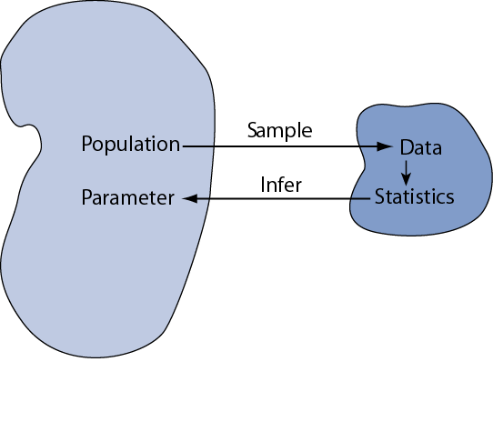
Statistical inference
Statistical inference:
Drawing conclusions about the whole population on the basis of a sample
Precondition for statistical inference:
A sample is randomly selected from the population (=probability sample)
We want to learn about population parameters…
…but we can only calculate sample statistics

Slide 236
Parameters and Statistics
We are going to illustrate inferential concept by considering how well a given sample mean reflects an underling population mean µ
µ

Slide 237
Key Relations between Population and Samples
Relation 1 (central limit theorem): the sampling distribution of tends toward Normality even when the population is not Normal (esp. strong in large samples).
Relation 2 (unbiasedness): the expected value of is μ
Relation 3 is related to the square root law, which says:
Again, the square root law says:
Notes:
This slide summarizes three major facts about SDMs (sampling distribution of a mean, abbreviated as SDM).
The standard deviation of the sampling distribution of the mean has a special name: standard error of the mean (denoted σ_{xbar} or SE_{xbar})

Slide 238
Forecasting
An essential aspect of managing any organization is planning for the future.
Organizations employ forecasting techniques to determine future inventory, costs, capacities, and interest rate changes.
There are two basic approaches to forecasting:
-Qualitative
-Quantitative

Slide 239
Qualitative Approach to Forecasting
Delphi Method
A panel of experts, each of whom is physically separated from the others and is anonymous, is asked to respond to a sequential series of questionnaires.
After each questionnaire, the responses are tabulated and the information and opinions of the entire group and the central value are made known to each of the other panel members so that they may revise their previous forecast response.
The process continues until some degree of consensus is achieved.

Slide 240
Quantitative Method
Time Series Data
Time Series Data is usually plotted on a graph to determine the various characteristics or components of the time series data.
There are 4 Major Components:
Trend,
Cyclical,
Seasonal, and
Irregular Components.

Slide 241
Components of a Time Series
The trend component accounts for the gradual shifting of the time series over a long period of time.
Any regular pattern of sequences of values above and below the trend line is attributable to the cyclical component of the series.
The seasonal component of the series accounts for regular patterns of variability within certain time periods, such as over a year.
The irregular component of the series is caused by short-term, unanticipated and non-recurring factors that affect the values of the time series. One cannot attempt to predict its impact on the time series in advance.

Slide 242
Measures of Forecast Accuracy
Mean Squared Error (MSE)
The average of the squared forecast errors for the historical data is calculated. The forecasting method or parameter(s) which minimize this mean squared error is then selected.
Mean Absolute Deviation (MAD)
The mean of the absolute values of all forecast errors is calculated, and the forecasting method or parameter(s) which minimize this measure is selected. The mean absolute deviation measure is less sensitive to individual large forecast errors than the mean squared error measure.
You may choose either of the above criteria for evaluating the accuracy of a method (or parameter).

Slide 243
Trend Projection
If a time series exhibits a linear trend, the method of least squares method may be used to determine a trend line (projection) for future forecasts.
Least squares, also used in regression analysis, determines the unique trend line forecast which minimizes the mean square error between the trend line forecasts and the actual observed values for the time series.
Example: The independent variable is the time period and the dependent variable is the actual observed value in the time series.

Slide 244
Trend Projection
Using the method of least squares, the formula for the trend projection is:
Y_{t} = b₀ + b₁t.
where: Y_{t} = trend forecast for time period t
b₁ = slope of the trend line
b₀ = trend line projection for time 0 (i.e. constant part)
nΣ tY_{t} - Σt ΣY_{t}
nΣt ² - (Σt )²
And,
where: Y_{t} = observed value of the time series at time period t
= average of the observed values for Y_{t}
= average time period for the n observations
b₁ =

Slide 245
Example: Plumbing Service
The number of plumbing repair jobs performed by a Plumbing Service in each of the last nine months are listed below.
Month Jobs Month Jobs Month Jobs
March 353 June 374 September 399
April 387 July 396 October 412
May 342 August 409 November 408
Forecast the number of repair jobs the Plumber will perform in December using the least squares method.

Slide 246
Plumbing Service: Trend Projection
Trend Projection
(month) t Y_{t} tY_{t} t ²
(Mar.) 1 353 353 1
(Apr.) 2 387 774 4
(May) 3 342 1026 9
(June) 4 374 1496 16
(July) 5 396 1980 25
(Aug.) 6 409 2454 36
(Sep.) 7 399 2793 49
(Oct.) 8 412 3296 64
(Nov.) 9 408 3672 81
Sum 45 3480 17844 285

Slide 247
Example: Plumbing Service
Trend Projection (continued)
= 45/9 = 5 = 3480/9 = 386.667
nΣtY_{t} - Σ t Σ Y_{t} (9)(17844) - (45)(3480)
b₁ = = = 7.4
n Σ t ² - (Σ t)² (9)(285) - (45)²
= 386.667 - 7.4(5) = 349.667
Thus our trend line is Y_{t} = 349.667 + 7.4 t.
Y₁₀ = 349.667 + (7.4)(10) =
423.667
For December t=10

Slide 248
Regression Analysis
Regression Analysis is similar to trend analysis, except the independent variable is not restricted to time.
For this model, we can find the regression equation in the same manner in which we have found the trend line except we would call the independent variable x, instead of t.
Regression analysis is used to indicate the cause-and-effect relationship between X and Y, that is a change in the value of independent variable X causes a corresponding change (effect) in the value of dependent variable Y if all other factors that affect Y remain unchanged.
Correlation analysis, in contrast, assures the existence of an association between two variables X and Y but not that they have a cause and effect relationship.

Slide 249
Regression Equation
Using the method of least squares, the formula for the regression line is:
Y = b₀ + b₁x.
where: Y= dependent variable which depends on the value of x
b₁ = slope of the regression line
b₀ = regression line projection for x= 0 ( i.e. Constant value)
nΣ X_{i}Y_{i} - ΣX_{i} ΣY_{i}
nΣX_{i}² - (ΣX_{i})²
where: Y = observed value of the independent variable X
= average of the observed values for Y
x­ˉ = average of independent variable for the n observations
Here, b₁ =
i
i
i

Slide 250
Example: Regression Analysis
Estimate the increase in sales revenue expected from an increase of 7.5 percent in advertising expenditure
Firm | Annual pc increase in Advertising expenditure | Annual pc increase in Sales revenue
A | 1 | 1
B | 3 | 2
C | 4 | 2
D | 6 | 4
E | 8 | 6
F | 9 | 8
G | 11 | 8
H | 14 | 9

Slide 251
Solution: Here, Sales revenue (Y) is dependent on advertising expenditure (X). Calculation for Regression Equation
Sales Revenue (Y) | Advertising Expenditure (X) | X² | XY
1 | 1 | 1 | 1
2 | 3 | 9 | 6
2 | 4 | 16 | 8
4 | 6 | 36 | 24
6 | 8 | 64 | 48
8 | 11 | 121 | 88
9 | 14 | 196 | 126
40 | 56 | 524 | 373
nΣ X_{i}Y_{i} - ΣX_{i} ΣY_{i}
8x 373- 40x56 2984- 2240 744
Here, b₁ =
= --------------------- = ------------------- = --------- = 0.704
nΣX_{i}² - (ΣX_{i})²
8x524 – (56)² 4192- 3136 1056
Or, bo = 5- 0.704 x 7 = 0.072;
Hence, Regression equation is Y = 0.072 + 0.704 X
Value of Y for X = 0.075 is 12.48%

Slide 252
SQC
Statistical Quality Control

Slide 253
Introduction to SQC
Talking about solving quality problems is not enough. We need specific tools that can help us make the right quality decisions.–
These tools come from the area of statistics and are used to help identify quality problems in the production process as well as in the product itself.
Statistical quality control (SQC) is the term used to describe the set of statistical tools used for measuring the quality performance, for acceptance/rejection decisions and to initiate CA/PA by quality professionals.

Slide 254
Sample represents Population
Statistical method is used for determining the extent to which quality goals are being met without necessarily checking every item produced.
This also helps in indicating whether or not the variations which occur in the conversion process are exceeding the limits of tolerances allowed by the customer and
This provides early warning for CA/PA
Thus it helps us to decide whether to reject or accept a particular product.
And ensure that the products produced are meeting customer needs.

Slide 255
SQC- Types of Variations
Statistical quality control exercise begins with the assumptions that no two products manufactured by a process are absolutely identical.
If variability is inevitable in any product or process, then how much of the variation is unavoidable? This raises the need for quality control.
The causes of variation in the quality of products or services from standards can be divided into the following two categories
Chance or common causes of variation
They are inherent to the process and cannot be reduced or eliminated without modification in the process itself. When the variability present in a process is confined to chance variation, the process is said to be in a state of statistical control.
Assignable causes of variation
The variation may be due to non-random causes. This may be due to the abnormality in the input material, or may be abnormality in the manufacturing processes, caused by the inefficiency of the operator or the machine.

Slide 256
Three SQC Categories
SQC can be divided into three broad categories:
Descriptive statistics
Descriptive statistics are used to describe quality characteristics and relationships.
e.g. the mean, standard deviation, and range
Acceptance Sampling
Acceptance sampling is the process of randomly inspecting a sample of goods and deciding whether to accept or reject the entire lot based on the results.
Does not help to catch in-process problems
Statistical process control (SPC)
Involves inspecting the output from a process
Quality characteristics are measured and charted
Helpful in identifying in-process variations and taking corrective actions

Slide 257
Use of the Three
Descriptive Statistics
Descriptive statistics are used to describe certain quality characteristics, such as the central tendency and variability of observed data. Although descriptions of certain characteristics are helpful, they are not enough to help us evaluate whether there is a problem of unacceptable quality with the lot.

Slide 258
Measure of Central tendency
A measure of central tendency is a single number used to represent the centre of the Grouped Data.
Different variables may possess different numerical characteristics. So different measures of Central Tendency is required.
Mode
Median
Mean
This class of measures can be for group or ungrouped data.

Slide 259
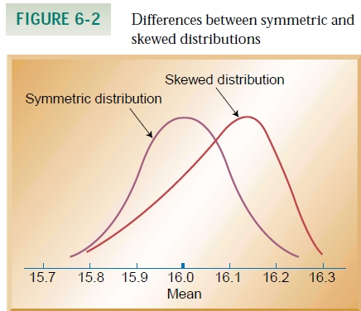
The Mode
The Mode is the most frequently occurring value in a group of raw scores.

Slide 260
The Median
The Median is defined as the middle value (of cases) of n values of X objects arranged in order of size
For odd no of cases the Middle Value will be (n+1)/2.
For even no of cases the Middle Value will be half way between the n/2 and (n+1)/2.

Slide 261
The Mean
x1+x2+x3+….. + xn
For Samples : X̅ = -------------------------------------
n
X1+X2+X3…………XN
For populations : μ= ----------------------------
N

Slide 262
Use of the Three
Acceptance Sampling
Descriptive Statistics does not help us in deciding whether a group of data is acceptable or not.
Acceptance sampling can help us to do this. Acceptance sampling helps us to decide whether desirable quality has been achieved for a batch of products, and whether to accept or reject the items produced.

Slide 263
Usefulness of Acceptance Sampling
Acceptance sampling is very useful when
Large no of items are processed in a short time
The cost of passing defective is low
Fatigue and boredom is caused by large no of items inspection.
Destructive testing is required

Slide 264
RISK
RISKS for the producer and consumer in sampling plans:
Acceptable Quality Level (AQL)
Max. acceptable percentage of defectives defined by producer.
α (Producer’s risk)
The probability of rejecting a good lot.
Lot Tolerance Percent Defective (LTPD)
Percentage of defectives that defines consumer’s rejection point.
β (Consumer’s risk)
The probability of accepting a bad lot.

Slide 265
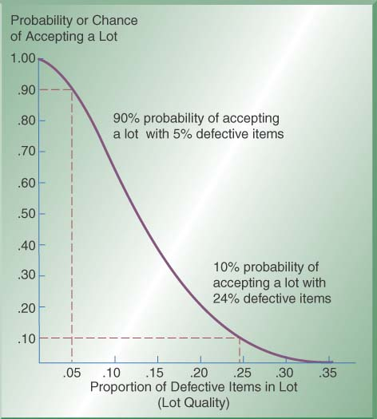
Operating Characteristics (OC) Curves
Operating Characteristic (OC) Curve: This curve plots the probability of accepting the lot (Y-axis) versus the lot fraction or percent defectives (X-axis). The OC curve is the primary tool for displaying and investigating the properties of a LASP (Lot Acceptance Sampling Plan).
X-axis shows % of items that are defective in a lot- “lot quality”
Y-axis shows the probability or chance of accepting a lot
As proportion of defects increases, the chance of accepting lot decreases
Example: 90% chance of accepting a lot with 5% defectives; 10% chance of accepting a lot with 24% defectives

Slide 266
Introducing Statistical Process Control
A manufacturing process when in a statistical control also provides the limits of its natural variation, which may be calculated with the help of Statistical tools. Such limits are drawn for process control at the shop floor level and are known as Control Charts.
Abnormality in the process causes variations in the products which are not acceptable by the customer and can be tracked with the help of the above Control Charts during the manufacturing process.
Information received by plotting observed quality data on the Control Charts can be used to control the process and produce goods within the acceptable quality standards. This is known as Statistical Process Control.

Slide 267
Control Charts
Control Charts are graphs that establish control limits of a process
Control limits
upper and lower bands of a control chart
Types of charts
Variables
range (R-chart)
mean (x̅ – chart)
Attributes
p-chart
c-chart

Slide 268
Control Charts
Control Charts provide a basis of monitoring variations in the predetermined quality of a product or process.
The use of control charts help to
Focus on the time dimension in which a system produces products or services
Identify the nature of variation in the process during operation and
Ensure that only acceptable products or services are produced by monitoring the process average, which is expected to stay within the bounds of upper and lower statistical limits.
Whenever an out-of control situation is detected, corrective action will be taken to bring the process back into control.
A Control Chart is essentially a graphic device for presenting data so as to identify the frequency and extent of variations from established standards.

Slide 269
Control Charts by Variables
Control Charts by variables are the followings
The Average Chart (X̅- Chart), which assumes the central tendency of the process
The Range Chart (R-chart), which measures the spread of the process
Since the Average Chart and Range Charts are usually used together , they are commonly known as (X̅-R) chart.

Slide 270
Theory underlying X̅-R Chart
Average of a sample of several items tend to cancel out the normal process variations and Undesirable changes due to assignable causes thereafter become visible.
Statistical limits of the X̅-R chart are based on the concept-
The Arithmetic Means of samples are distributed according to normal distribution with sample mean X̿, which is equal to mean of the population μ and Standard Deviation of sample means σ x̅ equal to √σ/n, where σ is the standard deviation of the Population and n is the sample size.

Slide 271
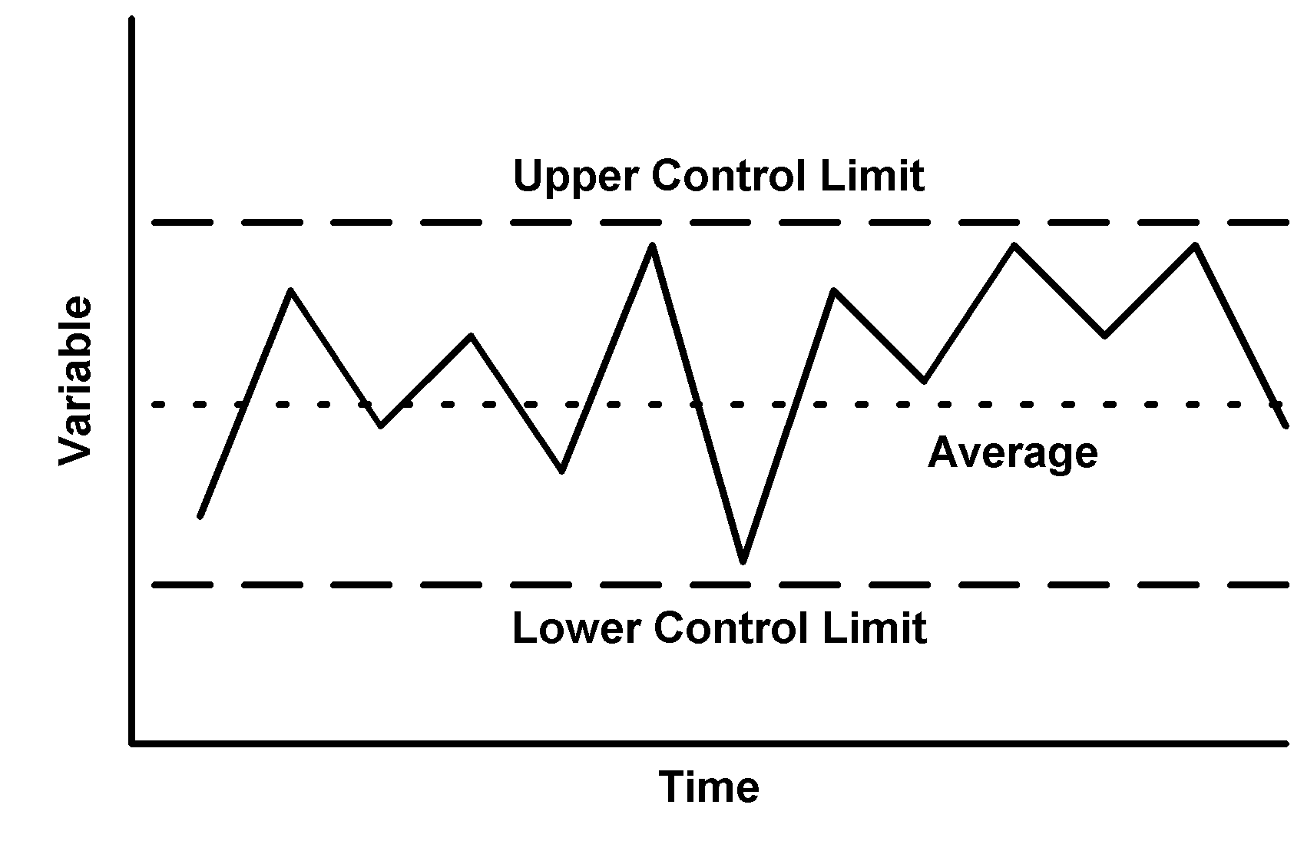
Control Chart
A Control Chart consists of three horizontal lines called Control limits which are within +/- 3 Standard Deviation of the Statistical measures
Upper Control Limit (UCL) indicates the upper limits of the tolerance
Lowe Control limits (LCL) indicating the lower limit of the tolerance.
Average or Central line should be the designed mean .
If all the product measures are found to be between the upper and lower control limits, it is assumed that the process is “in Control” and only chance causes are present.

Slide 272
Setting Up of Control Chart Using X̄ -R Chart
The Construction of an X̄ Chart is based on the Central Limit Theorem. This states that
Regardless of the population of all parts of services, the distribution of X̄ s (each of which
is the mean of a sample drawn from the population) will tend to follow a normal curve
as the sample size increases, where
The mean of population = μ
= sample mean
And Standard Deviation of sample
means σ x̅ equal to √σ/n, where σ is
the standard deviation of the Population
and n is the sample size.
Control Charts can be recalculated as
Where, A2, D3, D4 are Statistical Constants

Slide 273
Steps to follow in making X̅- R Chart
For X̅ Chart
Step-1 :- Calculate Sample Mean (X̅) and Sample Range (R) of each sample lot
Step-2 :- Calculate total Population average and the Mean Range (X̿ and R̅ )
Step-3 :- Set up a X̅ Control Chart for the Average from X̿ + A2 R̅ for UCLx̅ and X̿ - A2 R̅ for LCLx̅
For R-Chart
Step-4 :-Calculate Control Limits for the Range Chart by using UCLR as D4R̅ and LCLR as D3R̅
Step-5:- Set up a Range Chart and comment with both X̅ and R chart.

Slide 274
Problem Sum
A line inspector in an engineering company recorded dimensions of each of the 5 jobs selected at the end of every half an hour of the 5 hours in the shift. The design specifications are 25.0 +/- 0.10.
Plot X̅-R chart and find out which of the given observations are out of control. Given- A2= 0.5768, D3 =0, D4= 2.114
Sample Individual Measurements No. 1 2 3 4 5
1 25.00 25.01 25.00 25.03 25.01
2. 25.00 25.03 25.00 25.04 25.03
3. 25.01 25.02 25.02 25.03 25.02
4. 25.01 25.02 25.02 25.01 25.04
5. 25.02 25.02 25.03 25.03 25.00
6. 25.06 25.03 25.02 25.00 24.99
7. 24.99 24.98 25.02 25.02 24.99
8. 25.02 25.01 25.01 24.99 25.02
9. 25.03 25.01 24.97 25.01 25.03
10. 25.02 24.99 24.99 24.98 24.97

Slide 275
Computations: -
Sample No. | Individual Measurements 1 2 3 4 5 |  |  |  |  | X̄ | R
1 | 25.00 | 25.01 | 25.00 | 25.03 | 25.01 | 25.01 | 0.03
2 | 25.00 | 25.03 | 25.00 | 25.04 | 25.03 | 25.02 | 0.04
3 | 25.01 | 25.02 | 25.02 | 25.03 | 25.02 | 25.02 | 0.02
4 | 25.01 | 25.02 | 25.02 | 25.01 | 25.04 | 25.02 | 0.03
5 | 25.02 | 25.02 | 25.03 | 25.03 | 25.00 | 25.02 | 0.03
6 | 25.06 | 25.03 | 25.02 | 25.00 | 24.99 | 25.02 | 0.07
7 | 24.99 | 24.98 | 25.02 | 25.02 | 24.99 | 25.00 | 0.04
8 | 25.02 | 25.01 | 25.01 | 24.99 | 25.02 | 25.01 | 0.03
9 | 25.03 | 25.01 | 24.97 | 25.01 | 25.03 | 25.01 | 0.06
10 | 25.02 | 24.99 | 24.99 | 24.98 | 24.97 | 24.99 | 0.05
 |  |  |  |  |  | X̄̄ | R̄
 |  |  |  |  |  | 25.01 | 0.04

Slide 276
X̄ Chart
Diameter Measurement
UCL
CL
LCL
Sample N0.
Computations: - Central Line = CLx̄ = X̿ = 25.01 Upper Control Limit UCLx̄ = X̿ + A2R̄ = 25.01+ .5768X.04 = 25.03 Lower Control Limit LCLx̄ = X̿ - A2R̄ = 25.01- .5768X .04 = 24.99

Slide 277
R-Chart
UCL
Range Value
CL
LCL
Sample No.
Computation
CLR = 0.04
UCLR = D4xR̄ = 2.114x 0.04 = 0.085
LCLR = D3xR̄ = 0

Slide 278
Example: SPC for bottle filling…
Sample | Observation (x_{i}) |  |  |  |  | Average | Range (R)
1 | 11.90 | 11.92 | 12.09 | 11.91 | 12.01
2 | 12.03 | 12.03 | 11.92 | 11.97 | 12.07
3 | 11.92 | 12.02 | 11.93 | 12.01 | 12.07
4 | 11.96 | 12.06 | 12.00 | 11.91 | 11.98
5 | 11.95 | 12.10 | 12.03 | 12.07 | 12.00
6 | 11.99 | 11.98 | 11.94 | 12.06 | 12.06
7 | 12.00 | 12.04 | 11.92 | 12.00 | 12.07
8 | 12.02 | 12.06 | 11.94 | 12.07 | 12.00
9 | 12.01 | 12.06 | 11.94 | 11.91 | 11.94
10 | 11.92 | 12.05 | 11.92 | 12.09 | 12.07

Slide 279
SPC for bottle filling…
Calculate the average and the range for each sample…
Sample | Observation (x_{i}) |  |  |  |  | Average | Range (R)
1 | 11.90 | 11.92 | 12.09 | 11.91 | 12.01 | 11.97 | 0.19
2 | 12.03 | 12.03 | 11.92 | 11.97 | 12.07 | 12.00 | 0.15
3 | 11.92 | 12.02 | 11.93 | 12.01 | 12.07 | 11.99 | 0.15
4 | 11.96 | 12.06 | 12.00 | 11.91 | 11.98 | 11.98 | 0.15
5 | 11.95 | 12.10 | 12.03 | 12.07 | 12.00 | 12.03 | 0.15
6 | 11.99 | 11.98 | 11.94 | 12.06 | 12.06 | 12.01 | 0.12
7 | 12.00 | 12.04 | 11.92 | 12.00 | 12.07 | 12.01 | 0.15
8 | 12.02 | 12.06 | 11.94 | 12.07 | 12.00 | 12.02 | 0.13
9 | 12.01 | 12.06 | 11.94 | 11.91 | 11.94 | 11.97 | 0.15
10 | 11.92 | 12.05 | 11.92 | 12.09 | 12.07 | 12.01 | 0.17

Slide 280
Then…
is the average of the averages
is the average of the ranges

Slide 281
Finally…
Calculate the upper and lower control limits

Slide 282
The X Chart
UCL = 12.10
X = 12.00
LCL = 11.90

Slide 283
The R Chart
UCL = 0.32
R = 0.15
LCL = 0.00

Slide 284
The X/R Chart
UCL
X
What can you conclude?
LCL
UCL
The process is in control
R
LCL

Slide 285
Control Charts by Attributes
This form of inspection is where the items comprising the sample are classified into two factions :
Acceptable “ and
“Non-acceptable”.
Such an inspection is termed as “Inspection by attributes”. This includes
Quantitative measurements are not possible as with the inspection for damages, matching of color against a standard shades, presence of bars, etc.
Quantitative measurements consume too much time with the inspection of p.c.d. of drilled holes etc. ( uses GO or NOGO gauge)

Slide 286
Control Charts by Attributes
The Control Charts by Attributes are basically the followings.
The Fraction Defective Chart (p-Chart) which records the proportion of defective items in a sample
The Number Defective Chart (np-Chart) which records the number of defective items in a sample
The Defects Chart (C- Chart) which records the number of defects in a component/ product

Slide 287
Control chart for Fraction Defectives
The control charts for fraction defectives is used where the products manufactured in the shops or products received from vendors are inspected and classified as either accepted or rejected.
This two way classification naturally leads to a binomial description of the standard error of the mean.
The Fraction Defective Chart (p-Chart) which records the proportion of defective items in a sample
The Number Defective Chart (np-Chart) which records the number of defective items in a sample

Slide 288
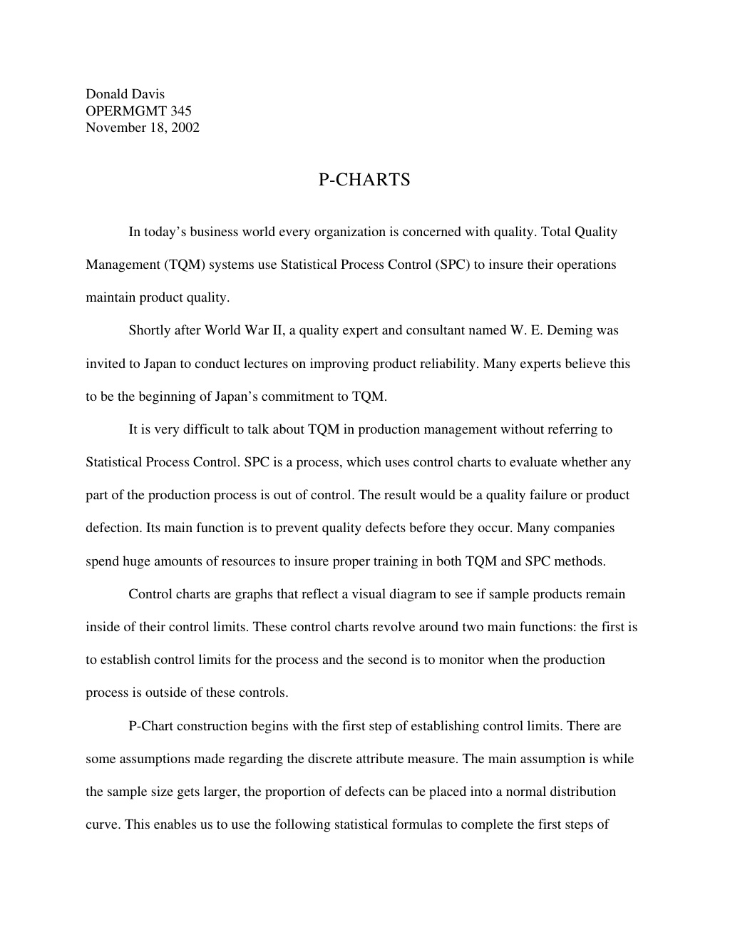

Slide 289
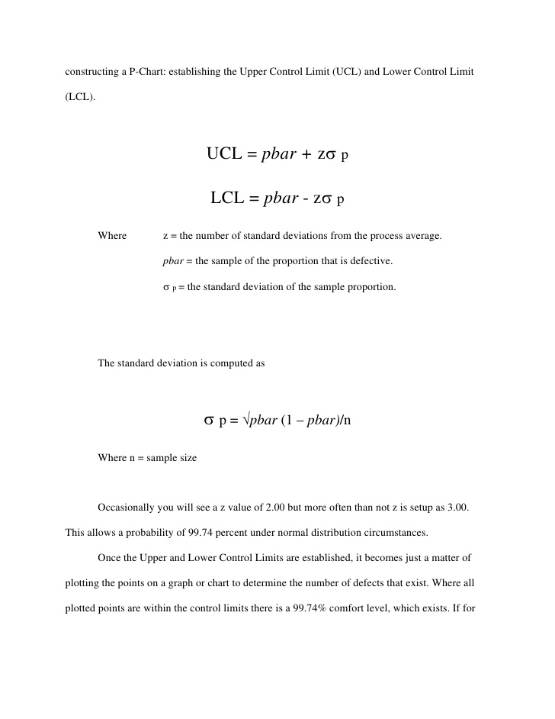
Z value can be 1.96 for 95% Confidence Interval.
More often than not, Z is set up as 3.0. This allows a probability of 99.74% under Normal Distribution.

Slide 290
Statistical Process Control with p Charts
When should we use p charts?
When decisions are simple “yes” or “no” by inspection
When the sample sizes are large enough (>50)
Sample (day) | Items | Defective | Percentage
1 | 200 | 10 | 0.050
2 | 200 | 8 | 0.040
3 | 200 | 9 | 0.045
4 | 200 | 13 | 0.065
5 | 200 | 15 | 0.075
6 | 200 | 25 | 0.125
7 | 200 | 16 | 0.080

Slide 291
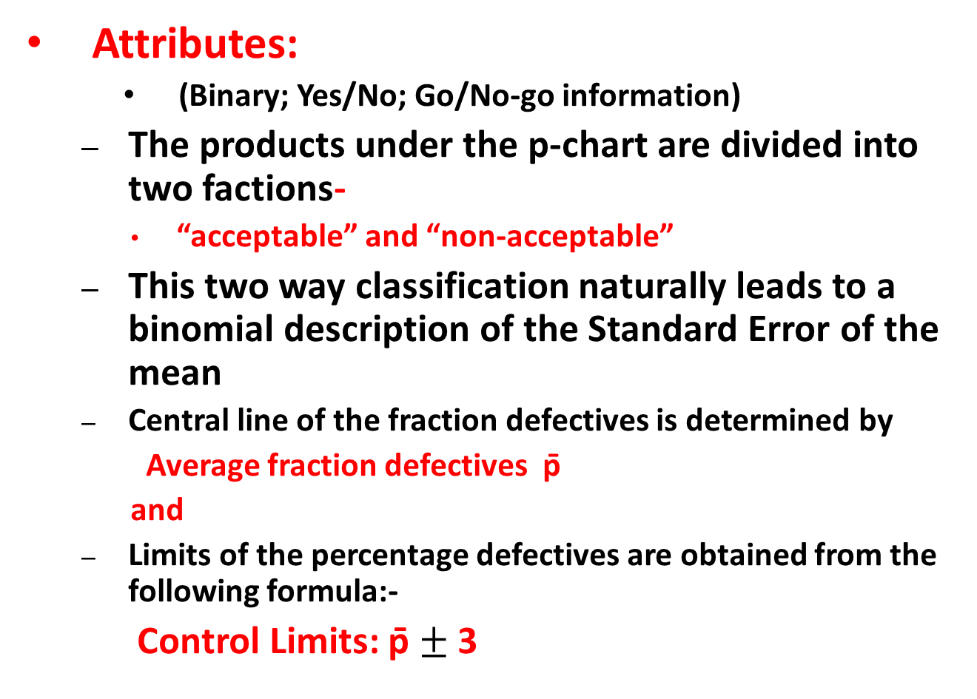
p-Chart
Attributes:
(Binary; Yes/No; Go/No-go information)
The products under the p-chart are divided into two factions-
“acceptable” and “non-acceptable”
This two way classification naturally leads to a binomial description of the Standard Error of the mean
Central line of the fraction defectives is determined by
Average fraction defectives p̄
and
Limits of the percentage defectives are obtained from the following formula:-
Control Limits: p̄ $±$3
-

Slide 292
Statistical Process Control with p Charts
Let’s assume that we take t samples of size n …

Slide 293
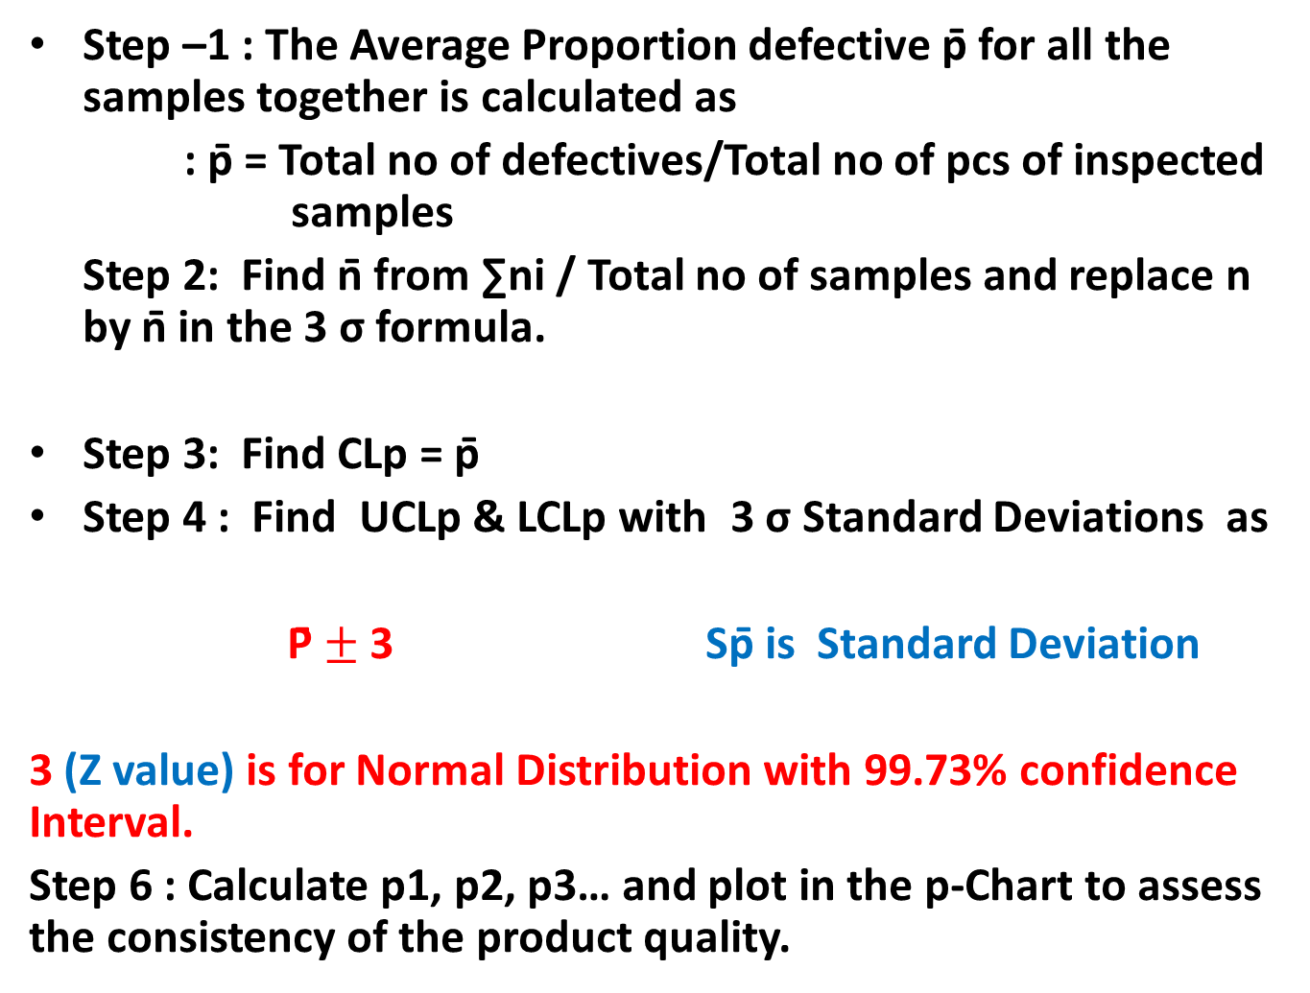
Steps to Construct p-Chart
Step –1 : The Average Proportion defective p̄ for all the samples together is calculated as
: p̄ = Total no of defectives/Total no of pcs of inspected samples
Step 2: Find n̄ from ∑ni / Total no of samples and replace n by n̄ in the 3 σ formula.
Step 3: Find CLp = p̄
Step 4 : Find UCLp & LCLp with 3 σ Standard Deviations as
P̄ $±$3 Sp̄ is Standard Deviation
3 (Z value) is for Normal Distribution with 99.73% confidence Interval.
Step 6 : Calculate p1, p2, p3… and plot in the p-Chart to assess the consistency of the product quality.
-

Slide 294
Statistical Process Control with p Charts

Slide 295
Statistical Process Control with p Charts
UCL = 0.117
p = 0.066
LCL = 0.015

Slide 296
Problem Example
Sample Number of No of item in each
Defective Sample
1 3 20
2 2 20
3 1 20
4 1 20
5 2 20

Slide 297

Computation of p-Chart
Sample No. | No of Defectives in each sample | No of items in each sample |  | Fraction Defective
1 | 3 | 20 |  | 0.15
2 | 2 | 20 |  | 0.1
3 | 1 | 20 |  | 0.05
4 | 1 | 20 |  | 0.05
5 | 2 | 20 |  | 0.1
Average Fraction Defective = p̄ = $\frac{Total No of Defective}{Total items inspected}$
= 9/100 = 0.09
Average no. per sample, n = 5x20/5= 20
Upper Control Limit = p̄ + 3 $√$p̄( 1-p̄)/n = 0.09 + 0.192 = 0.282
Lower Control Limit = p̄ - 3 $\sqrt{p}̄̄(1−p̄)/n$ = 0.09- 0.192
= -0.102=0
(Since the negative control limits are always taken as zero.)
-
-
--

Slide 298
Control Chart for Fraction Defective
UCL
CL
LCL
Sample No.

Slide 299
Problem Sum on p-chart
Six consecutive lots received from a vendor were inspected by sampling process In-coming Inspection of the buyer. Sample lot was varying as per the variation in the lot size. The inspection results are as follows :-
Construct a control chart for fraction defective and no of defectives.
Sample No | 1 | 2 | 3 | 4 | 5 | 6
Lot Size | 2850 | 1860 | 480 | 970 | 4385 | 2568
Sample Size | 125 | 125 | 50 | 80 | 200 | 125
No. of Defectives | 1 | 3 | - | 2 | 4 | 1

Slide 300
Solution
p̅ = Total No of defective items/ Total no. of items inspected
= (1+3+0+2+4+1)/125+125+50+80+200+125)=11/705= 0.016
Since the sample size is varying, find out avg. no. of pcs inspected n̅=705/6=117.5
Then UCLp= p̅+3 √ p̅(1- p̅)/n̅ =.016+3X0.0116= 0.051
LCLp=-0.019=0
np-chart
CLnp= n̅. p̅=0.016X117.5=1.88
UCLnp= n̅. p̅+ 3 √ n̅. p̅ (1- p̅)=1.88+3 √.016X117.5 (1.0X.016)=1.88+4.08=5.96
LCLnp= 1.88-4.08=0

Slide 301
Problem on p-Chart
Completed forms of a particular department of an insurance company were sampled daily to check the performance quality of the department. To establish a tentative norm for the department one sample of 100 units was collected each day for 15 days with these results.
Number of Forms |  |  | Number of Forms
Sample | Sample Size | With errors | Sample | Sample Size | With errors
1 | 100 | 4 | 9 | 100 | 4
2 | 100 | 3 | 10 | 100 | 2
3 | 100 | 5 | 11 | 100 | 7
4 | 100 | 0 | 12 | 100 | 2
5 | 100 | 2 | 13 | 100 | 1
6 | 100 | 8 | 14 | 100 | 3
7 | 100 | 1 | 15 | 100 | 1
8 | 100 | 3
Develop a p chart using a 95 percent confidence interval (1.96 Sp)
Plot the 15 samples collected
What comments you can make about the process?

Slide 302
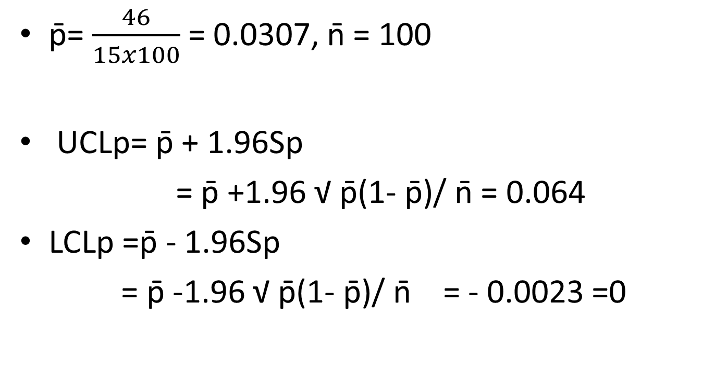
Solution
p̄= $\frac{46}{15x100}$ = 0.0307, n̄ = 100
UCLp= p̄ + 1.96Sp
= p̄ +1.96 √ p̄(1- p̄)/ n̄ = 0.064
LCLp =p̄ - 1.96Sp
= p̄ -1.96 √ p̄(1- p̄)/ n̄ = - 0.0023 =0

Slide 303
Control Chart
Proportion Defectives are plotted below
Of the 15 samples, 2 were out of Control limits. Because the control limits were established as 95 percent or 1 out of 20, we would say that the process is out of control.
It needs to be examined to find the cause of such wide spread variation.
UCL – 0.064
LCL=0.00

Slide 304
Problem Sums
Management is trying to decide whether Part A which is produced with a consistent 3 per cent defective rate, should be inspected.
If it is not inspected, the 3% defective will go through a product assembly phase and have to be replaced later.
If all Part A s are inspected, one third of the defectives will be found, thus raising the quality to 2% defectives.
Should the inspection be done, if the cost of inspection is Re. 0.01per unit and the cost replacing a defective in the final assembly is Rs. 4.00?
Suppose the cost of inspecting is Re 0.05 per unit rather than Re 0.01, will your answer change?

Slide 305
Answer
Should Part A be inspected?
0.03 defective with no inspection
0.02 defective with inspection
This problem can be solved by looking at the opportunity for 1% improvement.
Benefit = 0.01x (Rs. 4.00)= Re. 0.04
Cost of inspection= Re. 0.01
Therefore inspection will save Re. 0.03 per unit
A cost of Re.0.05 will be higher than the benefit of Re. 0.04 saved and hence not beneficial.

Slide 306
Defect Chart
The Defects Chart (C- Chart) which records the number of defects in a component/ product. The defects could occur at any spot but the probability of their occurrence at a particular spot is very small whereas the number of spots where the defects can occur are very large.
Such a situation is correctly described by Poission distribution with
Mean equal to average number of defects in all samples , say c̅. And
Standard deviation equal to √ c̅
Eg. Cloth is set by the number of imperfections in a given length.

Slide 307
Control Limits of c-Chart
Central Line , CLc = c̅
Since value of c can never be negative hence if the lower control limit (LCLc) works out to be negative, then it taken equal to zero.
Upper Control Limit, UCLc = c̅ +3√ c̅
Lower Control Limit LCLc = c̅ - 3√ c̅

Slide 308
Problem Sum on c-Chart
Ten woolen carpets were studied for total no. of defects in their texture. The details of the number of defects in each carpet are given below.
Carpet No. 1 2 3 4 5 6 7 8 9 10
No. of defects 2 4 3 5 1 3 2 3 4 3
All ten carpets are however were regarded as acceptable by the QC of the company. Construct a Control Chart for number of defects and comment.
Central Line-c̅ = Total no. of defects/ Number of carpets = 30/10 = 3
Upper Control Limit (UCLc) = c̅ + 3 √ c̅ = 3+ 3 √ 3= 3+5.2=8.2
Lower Control Limits (LCLc) = c̅ - 3 √ c̅ = 3 - 3 √ 3 = 3-5.2 = -2.2=0

Slide 309
Control Charts for No. of Defects
UCL
CL
No. of Defects
LCL
Sample No. (Carpet No.)

Slide 310
Process Capability Index Cp/C_{pk}
Cp And Cpk are the process capability indices.,
Cp-Measures the variation.,
how close the measures readings.,
Cpk -Measures the central tendency.,
how close the measures readings to Nominal

Slide 311

Production Function
Notes:
Each type of business or industrial activity, or simply any productive activity
(a productive activity is one that combines production factors with the objective of obtaining
a result in the form of goods or services) will have a different production function.

Slide 312
Cobb- Douglas Production Function
In economics, a Production Function represents the relationship between the output and the combination of factors, or inputs, used to obtain it.
Q=f(L,K)
Where: - Q is the quantity of products - L the quantity of labor applied to the production of Q, for example, hours of labor in a month. - K the hours of capital applied to the production of Q, for example, hours a machine has been working for the production of Q.
There can be other inputs, K and L are just examples.
The Cobb-Douglas production function is a particular form of the production function. It is widely used because it has many attractive characteristics, as we will see below.
The basic form of the Cobb-Douglas production function is as follows:
Q(L,K) = A L^β K^α
Where: - Q is the quantity of products. - L is the quantity of labor. - K is the quantity of capital. - A is a positive constant. - β and α are constants between 0 and 1.

Slide 313
Extension of Cobb-Douglas Production Function
The production function is the relationship that exists between the obtained output and the combination of factors used to obtain it.
Given the state of technology at any given moment in time, the production function shows us that the quantity of product Q that is obtainable by a business is a function of the quantities of
capital (K),
labor (L),
land (P) and
business initiative (H),
so that:
Q = f(K,L,P,H) ……..

Slide 314
Production Management
Production Management is defined as
Planning, implementation, and control of industrial production processes to ensure smooth and efficient operation.
Production management responsibilities include the traditional “five M's”: man, machine, method, material and money.
Managers are expected not only
to get the job done by the workforce
but also
to develop and maintain an efficient production process by building a learning organization,
where
environment is built for the employees to continuously learn and adapt new technologies, equipment and schedules.

Slide 315
Production to Operation Management
Production management which was formerly considered as manufacturing management only, now after inclusion of services into its scope, is broadly known as operations management.
The growth of service industry has brought with it the term operations management. It is a general term these days.
Operation Management deals with
managing resources
inputs:
machines, raw materials, human skills, etc.,
the conversion process, and
distribution of finished goods and services (outputs to the customers).

Slide 316
Systems approach to Management
Operation Management
Inputs
Conversion
Subsystem
Outputs
Control
Subsystem
Organization as a System receives Input, transforms it through a Process for Output, receives feed back from customer for improvements. either at Input stage or at conversion sub-system.

Slide 317
Functions of Production Management
Functions of Production and Operation Management are as follows:-
Planning
Planning conversion system
Operation strategies
Forecasting
Product and process choice
Operation capacity arrangement
Facility location planning
Layout planning
Schedule conversion system
Scheduling system in aggregate planning
Execution
Organizing for conversion
Job design , production/operation standards, works management
Executing as per plan
Implementing the plan efficiently and effectively
Controlling
Manage the deviation and improve
Review the process and product for continuous improvements
Material control
Inventory control
Material requirement planning
Managing for world class competition
Managing for quality
Quality control and analysis
Introduction of modern manufacturing system

Slide 318
Objectives of Production Management
Producing the right kind of goods and services that satisfies customer’s needs –Effectiveness objective
Maximizing output of goods and services with minimum resource inputs– Efficiency objective
Ensuring that goods and services produces that conform to quality needs of the customer
–Quality objective
Minimizing through put time –time required for conversions-by reducing delays waiting time, idle time etc.– Lead time objective
Minimizing cost of production-Cost objective
Maximizing utilization of machines, manpower, capital etc.– Capacity utilization objective

Slide 319
Types of Production Systems
On the basis of material flow characteristics the production system can be grouped into the following four categories
Mass Production or Flow line production system
Batch production system
Job shops
Unit manufacture or Project
Depending on the flow characteristics inside the system, the manufacturing system can be simple or complex to manage

Slide 320
Types of Production System
Job Shops: Small lots, low volume, general equipment, skilled workers, high-variety.
Ex: tool and die shop, veterinarian’s office
Batch Processing: Moderate volume and variety. Variety among batches but not inside.
Ex: paint production, Cake shop (Mio Amore)
Repetitive/Assembly: Semi-continuous, high volume of standardized items, limited variety.
Ex: auto plants (Maruti car manufacturing), cafeteria
Continuous Processing: Very high volume and no variety.
Ex: steel mill (SAIL), Indian Oil Refinery
Projects: Non-routine jobs.
Ex: AJC Bose Road Flyover

Slide 321
Product – Process Matrix
Dimension | Job Shop | Batch | Repetitive | Continuous
Job variety | Very High | Moderate | Low | Very low
Process flexibility | Very High | Moderate | Low | Very low
Unit cost | Very High | Moderate | Low | Very low
Volume of output | Very low | Low | High | Very high

Slide 322
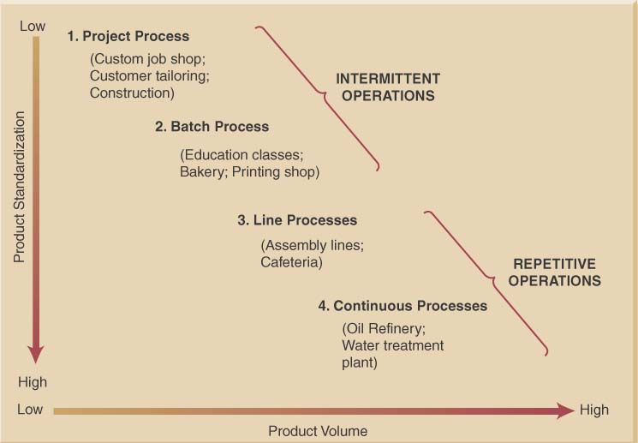
Product-Process Grid

Slide 323
Process Types
Process types can be:
Project process (Job Shops) – make a one-at-a-time product exactly to customer specifications
Batch process – small quantities of product in groups or batches based on customer orders or specifications
Line process (Repetitive Assembly)– large quantities of a standard product
Continuous process – very high volumes of a fully standard product
Process types exist on a continuum

Slide 324
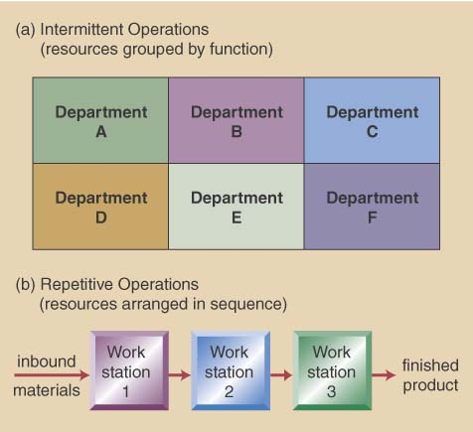
Intermittent VS. Repetitive Facility Layouts

Slide 325
Process Selection Considerations
Process selection is based on five principal considerations
Product-Process Grid
Degree of vertical integration
Flexibility of resources
Mix between capital & human resources
Degree of customer contact

Slide 326
Process Decisions-Vertical Integration & Make or Buy
Vertical integration refers to the degree a firm chooses to do processes itself- raw material to sales
Backward Integration means moving closer to primary operations
Forward Integration means moving closer to customers
A firm’s Make-or-Buy choices should be based on the following considerations:
Strategic impact
Available capacity
Expertise
Quality considerations
Speed
Cost (fixed cost + variable cost)make = Cost (fixed cost + Variable cost)buy
Business are trending toward less backward integration, more outsourcing

Slide 327
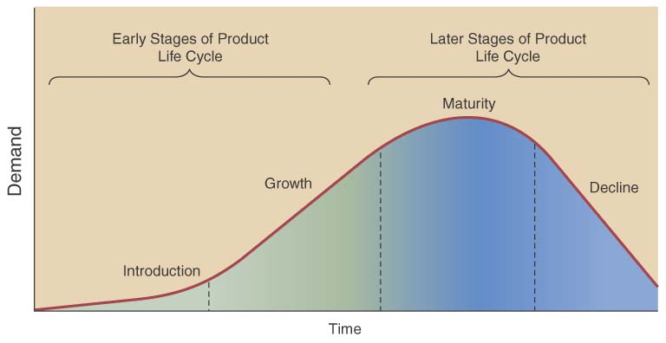
Product Life Cycle also affects decisions
Product life cycle – series of changing product demand
Consider product
life cycle stages
Introduction
Growth
Maturity
Decline
Facility & process investment depends on life cycle

Slide 328
Design of Services
Service design is unique in that the service and entire service concept are being designed
must define both the service and concept
- Physical elements, aesthetic & psychological benefits
e.g. promptness, friendliness, ambiance
Product and service design must match the needs and preferences of the targeted customer group

Slide 329
Designing Services vs Products
Services are different from manufacturing as they;
Produce intangible products
Involve a high degree of customer contact
Type of service is classified according to degree of customer contact

Slide 330
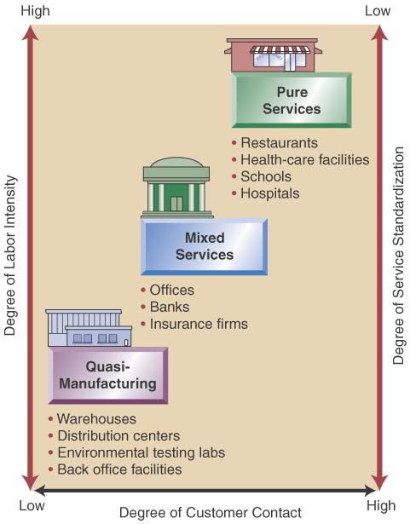
Service Design Matrix
Service Characteristics
Pure services
Quasi-Manufacturing
Mixed services
Service Package
The physical goods
The sensual benefits
The psychological benefits
Differing designs
Substitute technology for people
Get customer involved
High customer attention

Slide 331
TQM
Total Quality Management

Slide 332
TQM Definition
TQM is defined as “a management philosophy” that builds
a customer-driven organization dedicated to total customer satisfaction
through
continuous improvement in the effectiveness and efficiency of the organization and its processes.”
It uses PDCA Cycle (also Known as Deming Wheel ) as a tool to bring in continuous improvements.
Progress in the search for excellence depends largely on the leadership.
At work, total quality management (TQM) is best promoted when a leader is able to get everyone to be involved in activities designed to increase customer satisfaction.
TQM requires continual changes that contribute to quality improvement and the leader is responsible for finding the best avenue to achieve this.

Slide 333
TQM provides competitive edge to the organization
Customer buys the total experience not only the product alone. It starts from pre-selling activities (enquiry/quotation etc.), then the quality of the product or services delivered including the delivery and finally the after sales service including disposal.
TQM focuses on improving the total customer experience and on a continuing basis.
TQM is both a philosophy and a set of management guiding principles for managing an organization.
It typically regards customer reaction as the best measure of quality.
It uses the idea of internal customers to substitute for external customers in measuring the quality of many of the operations in the organization.
TQM regards focusing on quality as a way to gain competitive advantage. It is argued that if quality is improved, costs will drop and organizations will respond more quickly and effectively to customer requests.

Slide 334
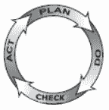
Plan-Do-Check-Act (PDCA) Cycle
The PDCA Cycle is a checklist of the four stages which is used to move from `problem-faced' to `problem solved‘ stage.
It is a four–step model for carrying out change. Just as a circle has no end, the PDCA cycle should be repeated again and again for continuous improvement.
When to Use Plan–Do–Check–Act
As a model for continuous improvement.
When starting a new improvement project.
When developing a new or improved design of a process, product or service.
When implementing any change.
The concept was originally developed by Walter Shewhart. But it was popularized by Edward
Deming for organization’s
improvement. Because of
this the cycle is also known
as Deming Wheel.

Slide 335
Plan–Do–Check–Act (PDCA)Procedure
Plan.
Recognize an opportunity and plan a change.
Do.
Test the change. Carry out a small-scale study.
Check.
Review the test, analyze the results and identify and record the learning.
Act.
Take action based on what is learned in the study step:
If the change did not work, go through the cycle again with a different plan. If you were successful, incorporate what you learned from the test into wider changes. Use what you learned to plan new improvements, beginning the cycle again.

Slide 336
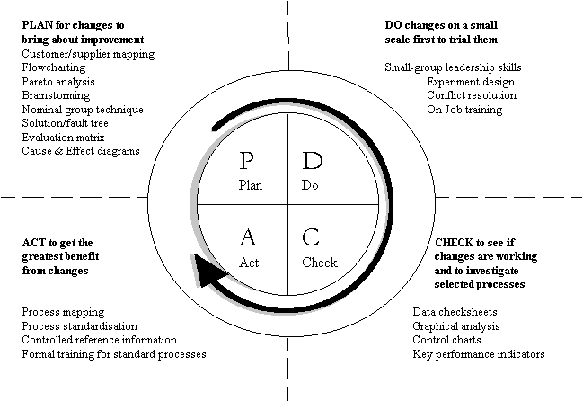
Common Improvement Tools used
in PDCA Cycle
Plan-Do-Check-Act describes the overall stages of improvement activity,
where other specific quality management, or continuous improvement, tools and techniques
are used for solving the problem. Some of the popularly used tools and techniques are shown
below which are used at each stage of the PDCA Cycle.

Slide 337
KAIZEN-what it means
KAI—CONTINUOUS
ZEN—GOOD
It’s a Japanese Management concept
-believes in
Incremental (Gradual & Continuous)
& Change ( for Improvement)

Slide 338
Kaizen Definition
Kaizen is defined as improvement.
It is a philosophy of continuing improvement that should be considered, not only at work, but at home as well.
When applied to the workplace Kaizen means continuing improvement that involves all employees - from top executives to laborers, and the managers in between.

Slide 339
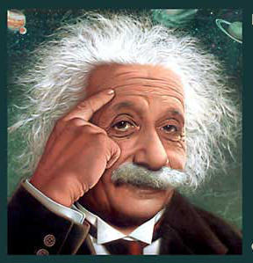
Without Change
There Can Be No Improvement
“The definition of insanity is doing the same thing over and over and expecting different results.”
Albert Einstein

Slide 340
Kaizen Implementation
Discard Conventional ideas
Think Positive
Question Current Practice
Identify low hanging fruits to target first
Find Root Causes
Choose the best among the alternative solutions
Implement
Work in a team to achieve MAXIMUM
Meeting of Kaizen group once in Month

Slide 341
Taguchi’s View of Variation
Traditional view is that quality within the LS and US is good and that the cost of quality outside this range is constant, where Taguchi views costs as increasing as variability increases, so seek to achieve zero defects and that will truly minimize quality costs.
High
High
Incremental
Cost of
Variability
Incremental
Cost of
Variability
Zero
Zero
Lower
Spec
Target
Spec
Upper
Spec
Lower
Spec
Target
Spec
Upper
Spec
Traditional View
Taguchi’s View
Notes:
30

Slide 342
6σ
Six Sigma-
a Business Management Strategy

Slide 343
Six Sigma
The term “Six Sigma Process," comes from the notion that
if a process has
a variation of up to six standard deviations from the mean are within the upper and lower specification limits,
there will be practically no items that will fail to meet the specifications;

Slide 344
Six Sigma
Six Sigma is a data driven approach which makes use of measuring and analyzing data to determine how defects and differences could be minimized to the virtual zero defect level.
Statistically the defect level targeted is 3.4 defects per million cycles/products, while a process is being run.
Six sigma is a customer based approach realizing that defects are expensive. Fewer defects mean lower costs and improved customer loyalty.
The lowest cost, high value producer is the most competitive provider of goods and services.
Six Sigma leads to achieve strategic business results.

Slide 345
Six Sigma Improvement Methods DMAIC vs. DMADV
Define
Measure
Analyze
Continuous Improvement
Reengineering
Improve
Design
Control
Validate

Slide 346
Marketing
Sales & Marketing

Slide 347
What is Marketing?
Marketing identifies consumer’s needs and organizes business activities to satisfy these needs.
Marketing is the flow of products and services to consumers and the transactions that facilitate or manage that flow.
Thus it can be defined as an activity concerning
Planning, implementing, coordinating and controlling of all activities that concern demand stimulation (ie. Promotion and advertisement), demand estimating, pricing and distribution of products and services.
Marketing is managing profitable customer relationship.

Slide 348
Selling vs Marketing
Selling
Marketing
Selling focuses on needs of the seller
Selling is converting goods and services into cash
Selling is push
Selling concerns existing products and it undertakes the task of pushing the sale of existing products
Marketing focuses on the need of the buyer
Marketing includes creating, delivering and facilitating consumption.
Marketing is pull
Marketing concerns customers and undertake the task of identifying market needs and converting customer needs into products.

Slide 349
Selling vs Marketing
Selling
Marketing
Selling seeks profit by pushing the existing products on the customer
In selling the firms make the product first and push the product in the market
In selling cost determines the price
Marketing seeks profit by making the product and distribution system at an affordable price to create and meet the customer demand
Marketing first identifies the demand and then creates it
In marketing price determines the cost

Slide 350
Selling vs Marketing
Selling
Marketing
Selling looks at the customer as the last link in the business
Transportation , storage and warehousing are treated as mere extension of production functions
Profits through sales volume
Marketing looks at the customer as the very purpose of the business
Transportation, storage and warehousing are essential services to meet the customer expectations.
Profit through customer satisfaction

Slide 351
Marketing Mix & the 4Ps
The marketing mix and the 4 Ps of marketing are often used as synonyms for each other. In fact, they are not necessarily the same thing.
"Marketing mix" is a general phrase used to describe the different kinds of choices organizations have to make in the whole process of bringing a product or service to market.
The 4Ps is one way – probably the best-known way – of defining the marketing mix.
Basic components of a 4P Marketing mix are
Product
Place (and Time)
Price
Promotion
The marketing mix model of 4Ps can be used to decide how to take a new offer to market.
It can also be used to test the existing marketing strategy
Notes:
Amongst the other marketing mix models that have been developed and have become popular over the years is 7Ps.
This is sometimes called the extended marketing mix, which includes the first 4 Ps, plus people, processes and physical layout decisions.

Slide 352
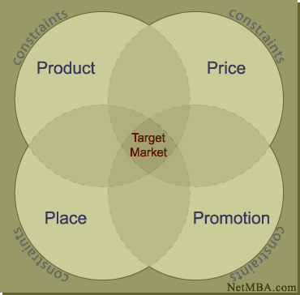
4Ps

Slide 353
4Ps
Product Marketing
What product/service(s) will I sell?
Product Includes branding and packaging and also the level of service (quality, dependability guarantees, etc.).
Product strategies may include concentrating on a
narrow product line, developing a highly specialized product or service, or
providing a product-service package containing unusually high quality service.
Some of the product strategies also include
Features-price trade-offs
Options and bundling
Kill your own products
(before competitors do)

Slide 354
4Ps
Place Marketing
Place (and Time) Method used to get the
product to target market i.e.
transportation,
marketing channel utilized,
market location.
Working through established distributors or
manufacturers' agents generally is easiest for small manufacturers. Small retailers consider cost and traffic flow in site selection, especially since advertising and rent can be reciprocal:
A low-cost, low-traffic location means spending more on advertising to build traffic.

Slide 355
4Ps
Price Marketing
The price of a product involves factors such as
cost of production,
competitors prices,
volume/ quality issues,
standard practices.
This also includes
Channel Pricing
Discounts
Terms etc.
The right price is crucial for maximizing total revenue. Generally, higher prices mean lower volume and vice-versa; however, small businesses can often command higher prices because of their personalized service.

Slide 356
4Ps
Promotion Marketing
• Promotion is communicating to customer about the product, place and price of the product.
Promotion strategies include advertising and direct customer interaction.
Good salesmanship is essential for small businesses because of their limited ability to spend on advertising.
Examples:
advertising
events
press releases
trade shows

Slide 357
Different Markets
Oligopoly
Duopoly
Oligopsony

Slide 358
Short-Term Objectives of Marketing: SMART
Specific – The objective achieves a particular, detailed result.
Measurable – There is a means to determine the objective.
Attainable – They are within economic and physical capabilities.
Rewarding – They are profitable and self satisfying as an initiative.
Timed – They have a specific timeline and/or deadline.

Slide 359
Marketing Planning
A marketing plan helps a marketer to establish, direct and coordinate marketing efforts.
A company looks at itself and the world around it to create a marketing plan for reaching goals.
A marketing plan contains information about the company and its products, marketing objectives and strategies. It provides yardstick by which the success of a firm’s marketing activities can be measured.
A marketing plan is a component of a business plan and aids in making the business strategy.
A marketing plan is based on a thorough understanding of the company’s product and services, their benefits and features, the target market and its characteristics. Knowledge of current and competitor’s current products and services along with the changes in the macro environment affecting the business is also necessary for the marketing plan.

Slide 360
Making a Marketing Plan
A marketing plan should be simple and precise.
While making a marketing plan, it should consider goals, strategy and the estimated costs and commensurate with the size and objectives of the plan.
Marketing plan considers the followings:
Product characteristics, end use, accessories, packaging etc.
Prices, including trade discounts, terms of sale etc.
Physical distribution strategy (Place)including the storage, warehousing and the method of distribution.
Role of channel partners including study of end users and their purchasing patterns, geographical locations, turnover, attitudes, etc.
Principal methods of promotion vis-à-vis advertising, direct contacts, sales promotion etc.
Industry practices including norms set by trade association, government bodies, inter-firm comparisons etc.

Slide 361


Marketing Planning
Elements of a Marketing Plan
Executive Summary
Executive summary
A brief overview of the entire marketing plan.
Situation Analysis
Situation analysis
The study of the internal and external factors that affect marketing strategies
Elements of a Marketing Plan
Marketing
Objectives & Goals
Marketing Strategies
Marketing Objectives & Goals
Objective to be achieved should be feasible, pragmatic and internally compatible.
Implementation
Marketing strategies
Strategy that identifies target markets and sets marketing mix choices that focus on those markets
Evaluation and Control

Slide 362
Marketing Research
Marketing research is the systematic gathering, recording and analyzing of data about problems relating to the marketing of goods and services.
Marketing research is not a science. It deals with people and their constantly changing feelings and behaviors, which are influenced by countless subjective factors.
Facts and opinions is to be gathered in an orderly, objective way to know the people’s buying behavior.
Marketing research focuses and organizes marketing information. It helps to:
Spot current and upcoming problems in the current market
Reduce business risks
Identify sales opportunities
Develop plans of action
Notes:
American Marketing Association (AMA) defines marketing research as the function which links the consumer, customer, and public to the marketeer through information. This information is used to identify and define marketing opportunities and problems; generate, refine, and evaluate marketing actions; monitoring marketing performance and improve understanding of marketing as a process.

Slide 363
Research Types, Methods and Techniques
Two types of research are available:
Primary research is original information gathered for a specific purpose.
Secondary research is information that already exists somewhere.
Primary research is conducted by asking customers or suppliers directly about the business, and/or about the product through
Direct-mail questionnaires
On-line or telephone surveys
Experiments
Panel studies
Test marketing
Behavior observation
Secondary research utilizes information already published in
Surveys, books, magazines, etc.
It is faster and less expensive than primary research.

Slide 364
Why it is important
People will not buy products or services, which they do not want.
Customers will not buy if they view the prices not consistent with what the product's value.
If the promotional programs cannot sensitize customers, they may not consider the offering as an option alternative.
Goods or services have to be at the right place to entice the customer to buy it.
Packaging and the logistics to reach the customer should also match their expectation.
Learning what customers want and how to present it drives the need for marketing research.

Slide 365
Advertising
Four criteria must be met for a communication to be classified as advertising:
The communication must be paid for
The advertiser must be identified
The communication must be delivered through mass media
The communication must be attempting to persuade
Notes:
Advertising is distinctive and recognizable as a form of communication by its three essential elements: its paid sponsorship, its use of mass media, and its intent to persuade. An advertisement is a specific message that an advertiser has placed to persuade an audience. An advertising campaign is a series of ads and other promotional efforts with a common theme placed to persuade an audience over a specified period. Integrated brand promotion (ibp) is the use of many promotional tools, including advertising, in a coordinated manner to build and maintain brand awareness, identity, and preference.

Slide 366
Model of the Communication Process
Advertising cannot be effective unless some form of communication takes place between the advertiser and the audience. However, advertising is about mass communication.
Advertising communication process can be defined as the message-production process versus the message-reception process, and consumers create their own meanings when they interpret advertisements.
Fields of Experience
Source /
Sender
Channel
Receiver /
Audience
Encoding
Decoding
MESSAGE
Response Feedback Loop

Slide 367
Advertising as a Communications Process
Production: The advertiser and social context determine ad content.
Reception: The context of ad reception and the audience’s understanding of an ad result in a meaningful interpretation of the ad.
Accommodation and negotiation: The ways in which consumers interpret ads

Slide 368
Audiences for Advertising:
Advertising takes many forms and serves different purposes from one application to another.
Advertising can be classified by audience category or by geographic focus.
Audience Categories
Household Consumers
Business Organizations
The Trade Channel
Professionals
Government
Geographic Focus
Global advertising
International advertising
National advertising
Regional advertising
Local advertising

Slide 369
The Role of Advertising in Brand Management
Advertising is one element of the marketing mix; the other key elements
are the firm’s products, their prices, and the distribution network.
Advertising must work in conjunction with these other marketing mix
elements if the organization’s marketing objectives are to be achieved.
It is important to recognize that of all the roles played by advertising in
the marketing process, none is more important than contributing to
building brand awareness and brand equity.
Roles played by advertising
Information and persuasion
Introduction of new brands and extensions
Building and maintaining brand loyalty/brand equity
Creating an image/meaning
Building brand loyalty in the trade channel

Slide 370
What is a brand?
A brand is a name, term, sign, symbol, design or a combination of the above to identify the goods or service of a seller and differentiate it from the rest of the competitors.
Brand identity is ‘a set of associations the brand strategist seek to create or maintain.’
The brand identity must express the particular vision and uniqueness of the brand – what the brand stands for basically
Branding is not possible, when
The product is a commodity

Slide 371
Brand Building
Involves all the activities that are necessary to nurture a brand into a healthy cash flow stream after launch
This is done through
Product development
Packaging
Advertising
Promotion
Sales and distribution

Slide 372
Brand Equity – Brand Extension
Brand Equity
Brand equity defines the value of the brand, the concept is a way to account for how much value a brand holds. Brand equity is one of the intangible entries on the balance sheet (like goodwill and know-how).
This refers to the consumers’ perception of the brand and is strategically valuable for brand management.
Brand extensions
A brand can be extended into new product categories. Brand extensions are often necessary when adapting to changes in the environment or in order to reap the full benefits of a strong brand.
Extensions have many benefits. In the beginning, brand extensions were used as a strategic tool mainly to enter new markets. Today, brand extensions are also used to underpin and develop the brand to meet market changes.

Slide 373
What is a Supply Chain?
The concept of Supply Chain Management is based on two core ideas.
The first is that
practically every product that reaches an end user represents the cumulative effort of multiple organizations. These organizations are referred to collectively as the supply chain.
The second idea is that
while supply chains have existed for a long time, most organizations have only paid attention to what was happening within their “four walls.” Few businesses understood, much less managed, the entire chain of activities that ultimately delivered products to the final customer. The result was disjointed and often ineffective supply chains.

Slide 374
What is Supply Chain Management?
Supply chain management is the active management of supply chain activities to maximize customer value and achieve a sustainable competitive advantage.
It represents a conscious effort by the supply chain firms to develop and run supply chains in the most effective & efficient ways possible.
Supply chain activities cover everything from product development, sourcing, production, and logistics, as well as the information systems needed to coordinate these activities.
The organizations that make the supply chain are “linked” together through physical flows and information flows.
Physical flows involve the transformation, movement, and storage of goods and materials. They are the most visible piece of the supply chain.
But just as important are information flows. Information flows allow the various supply chain partners to coordinate their long-term plans, and to control the day-to-day flow of goods and material up and down the supply chain.

Slide 375
Components of Supply Chain
All stages involved, directly or indirectly, in fulfilling a customer request
Includes manufacturers, suppliers, transporters, warehouses, retailers, customers
Supply Chain web or Supply Network includes the following supply chain stages:
customers,
retailers,
distributors,
manufacturers,
Suppliers
All stages may not be present in all supply chains (e.g., no retailer or distributor for Dell)
Within each company, the supply chain includes all functions involved in fulfilling a customer request
product development,
marketing,
operations,
distribution,
finance,
customer service

Slide 376
Logistics
Logistics, also known as physical distribution, encompasses the broad range of activities concerned with efficiently delivering raw materials, parts, semi-finished items, and finished products to designated places.
Logistics includes customer service, shipping, warehousing, inventory control, trucking operations, packaging, receiving, materials handling, and plant, warehouse, and store location planning.
Logistics affects costs, the value of customer service, and its relationship with other functional areas.

Slide 377
Inventory Management
Good inventory management provides a continuous flow of goods and matches the quantity of goods kept in inventory as closely as possible with customer demand.
To improve their inventory management, many firms are applying a just-in-time inventory system and electronic data interchange.
Four specific aspects of inventory management are stock turnover, when to reorder, how much to reorder, and warehousing.
Stock turnover refers to the number of times during a stated period (usually one year) that average inventory on hand is sold. It shows the relationship between a firm’s sales and the inventory level it maintains.
A reorder point depends on order lead time, the usage rate, and safety stock
The economic order quantity (EOQ) is the order volume corresponding to the lowest sum of order-processing and inventory-holding costs.

Slide 378
Reasons for Inventories
Improve customer service
To meet the variation in Customer demand, when unpredictable
Economies of purchasing
To reduce Purchasing cost and also get economy in freight inward costs
Economies of production
To reduce Set up costs and to reduce the effect of imbalance in Assy. line
To maintain independence of supply chain
To relieve pressure on production to get the goods out some how and assures uninterrupted service.

Slide 379
Reason For Inventory-contd.
Transportation savings
To bring economies in transportation and also to ensure reaching in time
Hedge against future
To avoid unplanned shocks (labor strikes, natural disasters, surges in demand, etc.)
To provide a Safeguard for variation in raw material delivery time
To get priority focus in vendor’s production plan and also to take care of adverse effect coming from failures in the vendor’s supply chain

Slide 380
EOQ Assumptions
Known and constant demand
Known and constant lead time
Instantaneous receipt of material
No quantity discounts
Only order (setup) cost and holding cost
No stockouts
Notes:
Students should be asked to consider the degree to which each of these assumptions is accurate.

Slide 381
Definition of Inventory Carrying Costs
Costs incurred for maintaining inventory of materials.
Holding(or Carrying ) costs
Includes
Costs of making Storage facilities
Handling
Insurance
Breakage
Obsolescence
Depreciation
Opportunity costs /Interest costs of Capital

Slide 382
Inventory Holding Costs (Appx. Ranges)- An example
Category
Housing costs (building rent, depreciation, operating cost, taxes, insurance)
Material handling costs (equipment, lease or depreciation, power, operating cost)
Labor cost from extra handling
Investment costs (borrowing costs, taxes, and insurance on inventory)
Pilferage, scrap, and obsolescence
Overall carrying cost
Cost as a
% of Inventory Value
6%
(3 - 10%)
3%
(1 - 3.5%)
3%
(3 - 5%)
11%
(6 - 24%)
3%
(2 - 5%)
26%
Notes:
Note that this slide suggest holding costs are, on average, about 26% of the inventory value

Slide 383
INVENTORY COSTS- contd.
Ordering Costs
Includes
purchasing costs
production ordering costs
The above costs include counting vis-à-vis order quantity, system costs for tracking the orders etc
Shortage Costs
Includes
costs for order waiting to be serviced
costs of order getting cancelled
It is difficult to obtain cost of lost customers, loss of profit, late delivery penalties, emergency service etc.

Slide 384
EOQ Model When To Order
Inventory Level
Optimal Order Quantity (Q*)
Average Inventory (Q*/2)
Reorder Point (ROP)
Time
Lead Time
Notes:
One should link this model to the assumptions. You should also explore, at least briefly, how this picture would change if the assumptions were not met.

Slide 385
EOQ Model How Much to Order?
Annual Cost
Total Cost Curve
Minimum total cost
Holding Cost Curve
Order (Setup) Cost Curve
Optimal Order Quantity (Q*)
Order quantity

Slide 386
Cost Relationships
Total Inventory Cost =
Annual Material Cost +
Annual ordering Cost +
Annual Inventory holding costs
TIC= DC + D/Q X S + Q/2 X H

Slide 387
Derivations
TIC - Total Inventory Cost
D – Annual Demand
C -- Cost per Unit
Q – Quantity to be ordered (EOQ)
S --Setup cost or Cost of Placing an Order
R --Reorder Point
L --Lead Time
H -- Annual Holding and storage cost per Unit of Average Inventory

Slide 388
Derivation of EOQ
To find Order Quantity when Total Cost is minimum. :--
TIC=DC+(D/Q)*S+(Q/2)*H
d(TIC)/dQ=0+(-DS/Q²) +H/2 =0
to be minimum
or, Q² =2DS/H
or, Q = 2DS/H

Slide 389
Inventory problem
A company has got a demand for particular part at 1000 units per month. The cost per unit is Rs 50 and it costs Rs 500 to place an order and to process the delivery. The inventory carrying costs at 20 % of average inventory investment cost.
Determine
Economic Order Quantity
Optimum no. of orders placed per annum
Minimum Total cost of inventory per annum
Notes:
EOQ= Q = $√$ 2DS/H
D = Annual Demand = 12X1000= 12,000
S= Ordering cost or Set Up cost = 500
H = Inventory Carrying Cost = 20% of average inventory investment cost =20% of Rs 50= Rs 10
So, Q = $\frac{\sqrt{2x12000x500}}{\sqrt{10}}$ = 1095
Optimum no. of orders per annum = 12000/1095 = 10.96 i.e. 11
Minimum Total Cost of inventory per annum, TC=DC+(D/Q)*S+(Q/2)*H
= 12000x50 + (12000/1095) 500 + (1095/2) x10
= 600,000 + 10.96x500 + 1095x5 = 600,000 + 5480 + 5475 = Rs. 610955

Slide 390
Economic Lot Size Determination with Quantity Discount
Basic economic order quantity formula is based on the assumption that price per unit is fixed irrespective of volume. But that is generally not true.
Often suppliers offer discount if higher quantities are purchased.
Quantity Discount reduces annual material cost and ordering cost but increases inventory carrying cost.
Hence the Total Cost function is no longer uniformly continuous but becomes a step wise continuous.
Comparison should be made with the total annual costs at each step to get the optimum.

Slide 391
Quantity Discount mode
Steps
Calculate EOQ at different price level
Decide the quantity to be purchased at each price level.
Consider EOQ or Minimum Quantity to be ordered to avail discount and take which ever is higher.
Calculate the Total Annual Cost at different Price level and EOQs
Select the optimal purchase quantity when Annual Total Cost is minimum.

Slide 392
Problem with Quantity Discount
A company has got a demand for particular part at 1000 units per month. The cost per unit is Rs 50 and it costs Rs 500 to place an order and to process the delivery. The inventory carrying costs at 20 % of average inventory investment cost.
Supplier offered a discount proposal which says that
If the quantity ordered per occasion is 2000, he will give Rs 10 discount per pce, and
If the quantity ordered per occasion is 5000 per occasion he will give Rs 20 per pce. as discount
Advise the optimum ordering quantity

Slide 393
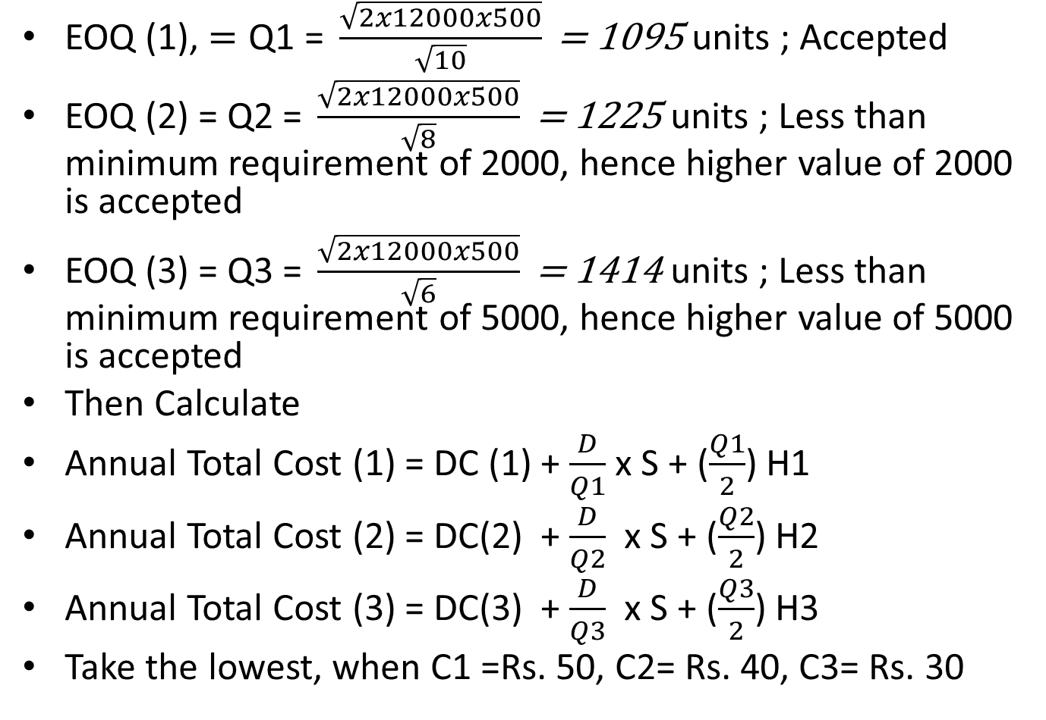
Solution
EOQ (1), $=\text{Q}\text{1 }\text{= }\frac{\sqrt{2x12000x500}}{\sqrt{10}}\text{ = }\text{1095 }$units ; Accepted
EOQ (2) = Q2 $\text{= }\frac{\sqrt{2x12000x500}}{\sqrt{8}}\text{ = }\text{1225 }$units ; Less than minimum requirement of 2000, hence higher value of 2000 is accepted
EOQ (3) = Q3 $\text{= }\frac{\sqrt{2x12000x500}}{\sqrt{6}}\text{ = }\text{1414 }$units ; Less than minimum requirement of 5000, hence higher value of 5000 is accepted
Then Calculate
Annual Total Cost (1) = DC (1) + $\frac{D}{Q1}$ x S + ($\frac{Q1}{2}$) H1
Annual Total Cost (2) = DC(2) + $\frac{D}{Q2}$ x S + ($\frac{Q2}{2}$) H2
Annual Total Cost (3) = DC(3) + $\frac{D}{Q3}$ x S + ($\frac{Q3}{2}$) H3
Take the lowest, when C1 =Rs. 50, C2= Rs. 40, C3= Rs. 30

Slide 394
Economic Production Quantity Model
This is an Inventory Model similar to EOQ model except that it is for Non-Instantaneous Replenishment.
In many situations the amount ordered is not delivered all at once, but the ordered quantity is sent or received gradually over a length of time at a finite rate per unit of time and the sale or consumption continues during the intervening period.
At this the inventory is being used while the new inventory is still being received at a faster rate to build up the stock to its highest level, when the incoming stops.
The quantity in stock is consumed till such time a reorder point is reached when one more batch is ordered and the cycle starts again.

Slide 395
PRODUCTION LOT SIZE MODELS
In a production lot size model, manufacturer, tries to determine how much to produce (the production lot size) during each production run.
Like the EOQ model, Q is the production lot size
except:
Annual Production rate :- P/yr.
which is greater than
Annual Demand rate:- D/yr.
Otherwise run process continuously and sell items as fast as they are produced
Inventory does not “jump” to Q but builds up to a value I_{MAX} that is reached when production is ceased

Slide 396
Additional Assumptions in EPL
Assumptions in Economic Production Lot Size Model are
i) Demand is continuous and at constant rate
ii) During the Production run, the production of the item is continuous and at a constant rate until the production of quantity (Q) is complete.
iii) The rate of receipt (P) is greater than the usage rate (D).
iv) Production runs in order to replenish inventory are made at regular interval.
v) Production set up cost is fixed, i.e. independent of quantity produced

Slide 397
EPL
Production Cycle Time
tp= Q/P
Amount Produced
Inv.
Level
Slope=P-D
Slope=-D
Production
Lot Size, Q
Imax
= tp(P-D)
Reorder Level
Time
tp
Inventory
Depletion time
Start
Prod.
Stop
Prod.
Start
Prod.

Slide 398
Maximum inventory and the Average inventory per cycle
During the production run time tp, the inventory increases at the rate of P and simultaneously decreases at the rate of D. Thus the inventory gradually builds up at the rate of (P-D) units during a production run and decreases at the rate of D between production runs.
Therefore, the maximum inventory level reached at the end of tp will be
Imax = Inventory accumulation rate X Production time
= (P-D) tp = (P-D) Q/P = (1-D/P) xQ
Since the minimum inventory level Imin = 0,
Average Inventory level will be Q/2 ( 1- D/P)

Slide 399
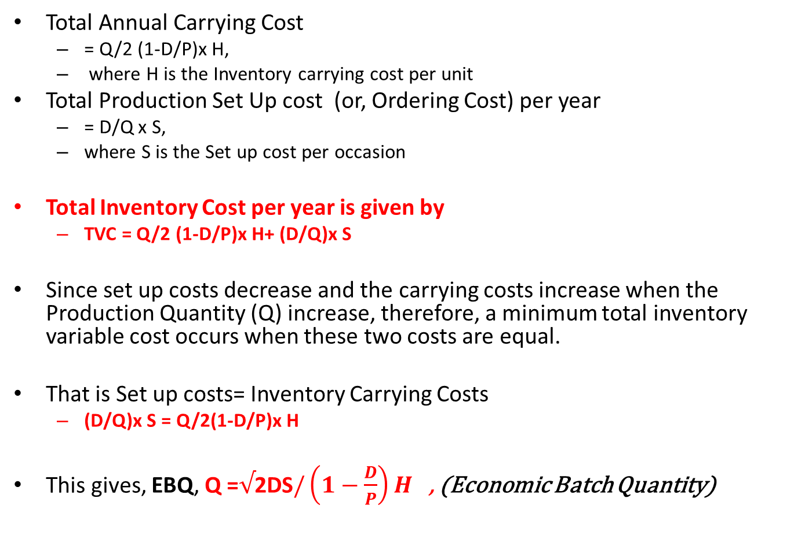
Economic Batch Quantity (EBQ)
Total Annual Carrying Cost
= Q/2 (1-D/P)x H,
where H is the Inventory carrying cost per unit
Total Production Set Up cost (or, Ordering Cost) per year
= D/Q x S,
where S is the Set up cost per occasion
Total Inventory Cost per year is given by
TVC = Q/2 (1-D/P)x H+ (D/Q)x S
Since set up costs decrease and the carrying costs increase when the Production Quantity (Q) increase, therefore, a minimum total inventory variable cost occurs when these two costs are equal.
That is Set up costs= Inventory Carrying Costs
(D/Q)x S = Q/2(1-D/P)x H
This gives, EBQ, Q =$√$2DS$/\left(1−\frac{D}{P}\right)H$ , (Economic Batch Quantity)

Slide 400
EBQ (Q*) Derivation (Alternative method)
TC(Q) = (D/Q)S + H(1-D/P)Q/2 + DC,
where C is the cost per unit
EBQ,

Slide 401
Problem Sums
A contractor has to supply 10,000 bearings per day to an automobile company. He finds that when he starts production run, he can produce 25000 bearings per day. The cost of holding a bearing in stock per year is Rs 2 and the set up cost of a production run is Rs 1800. How frequently should he produce?
Assume 300 working days per year.
D= 10,000 x 300 = 30,00,000 per year (assuming 300 working days in a year.)
P = 25,000 x 300= 75,00,000
H= Rs 2 per bearing per year
S= Rs. 1800 per set up time
Frequency of Production = /D = 94868/10,000= 9.5 days

Slide 402
EXAMPLE-- Farah Cosmetics
Production Capacity 1000 tubes/hr.
Daily Demand 1680 tubes
Production cost $0.50/tube (C = 0.50)
Set-up cost $150 per set-up (S = 150)
Holding Cost rate: 40% of unit cost,
i.e., H = .4(.50) = .20
Since demand is 1680 per day and the production rate is 1000 per hour:
D = 1680(365) = 613,200 (Annual Demand rate)
P = 1000(24)(365) = 8,760,000 (Annual Production rate)

Slide 403
OPTIMAL PRODUCTION LOT SIZE

Slide 404
TOTAL ANNUAL COST
TOTAL ANNUAL COST = TC(Q) = TVC(Q) + D x C
TVC(Q) = (D/Q)S + ((1-D/P)Q/2)H =
(150)(613,200/31,449) + .2((1-(613,200/8,760,000))(31,449)/2)
= $5,850
TC(Q) = TVC(Q) + D x C =
5,850 + .50(613,200) = $312,450

Slide 405
OTHER QUANTITES
Length of a Production run = Q*/P =
31,449/8,760,000 = .00359yrs. = .00359(365)
= 1.31 days
Length of a Production cycle = Q*/D =
31,449/613,200 = .0512866yrs. = .00512866(365) = 18.72 days
# of Production runs/yr. = D/Q* = 19.5
I_{MAX} = (1-(613,200/8,760,000))(31,449) = 29,248

Slide 406
MIS
A management information system (MIS) provides information that organizations require to manage themselves efficiently and effectively.
It provides business managers the information they need to make decisions and solve problems, while facilitating data from different aspects of the business.
An MIS provides three types of information to managers:
Detailed, which confirms activities
Summary, which puts information in an easy-to-read form
Exception, which deals with all information outside the normal scope of activities.

